Slide 1

Advances in understanding of root growth under hydric deficiency
Omar Borsani
Laboratorio de Bioquímica
Depto. Biología Vegetal
Facultad de Agronomía
Universidad de la República-URUGUAY

Slide 2

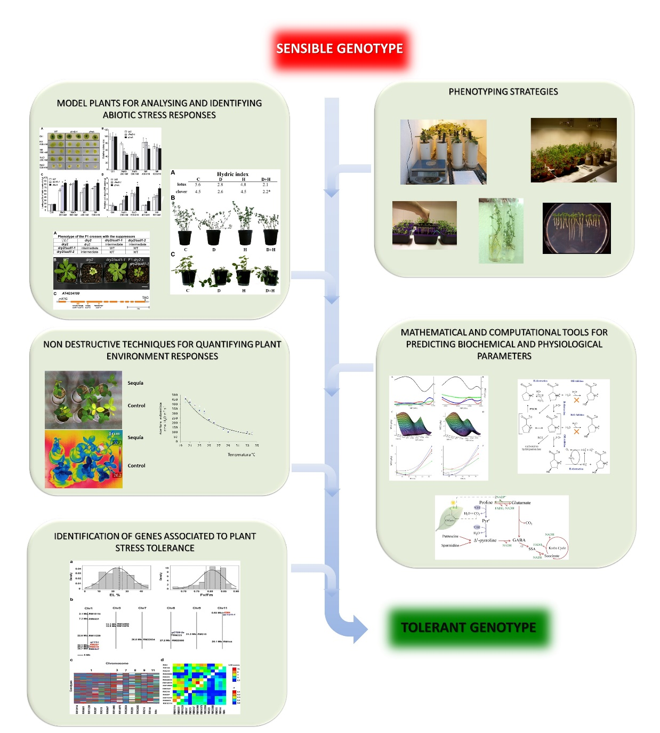
Work flow for a multi-approach strategy for plant drought responses analysis

Slide 3


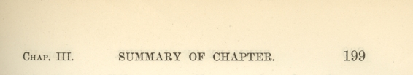
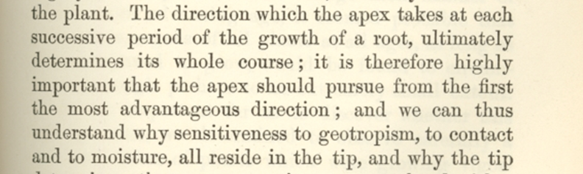


Slide 4
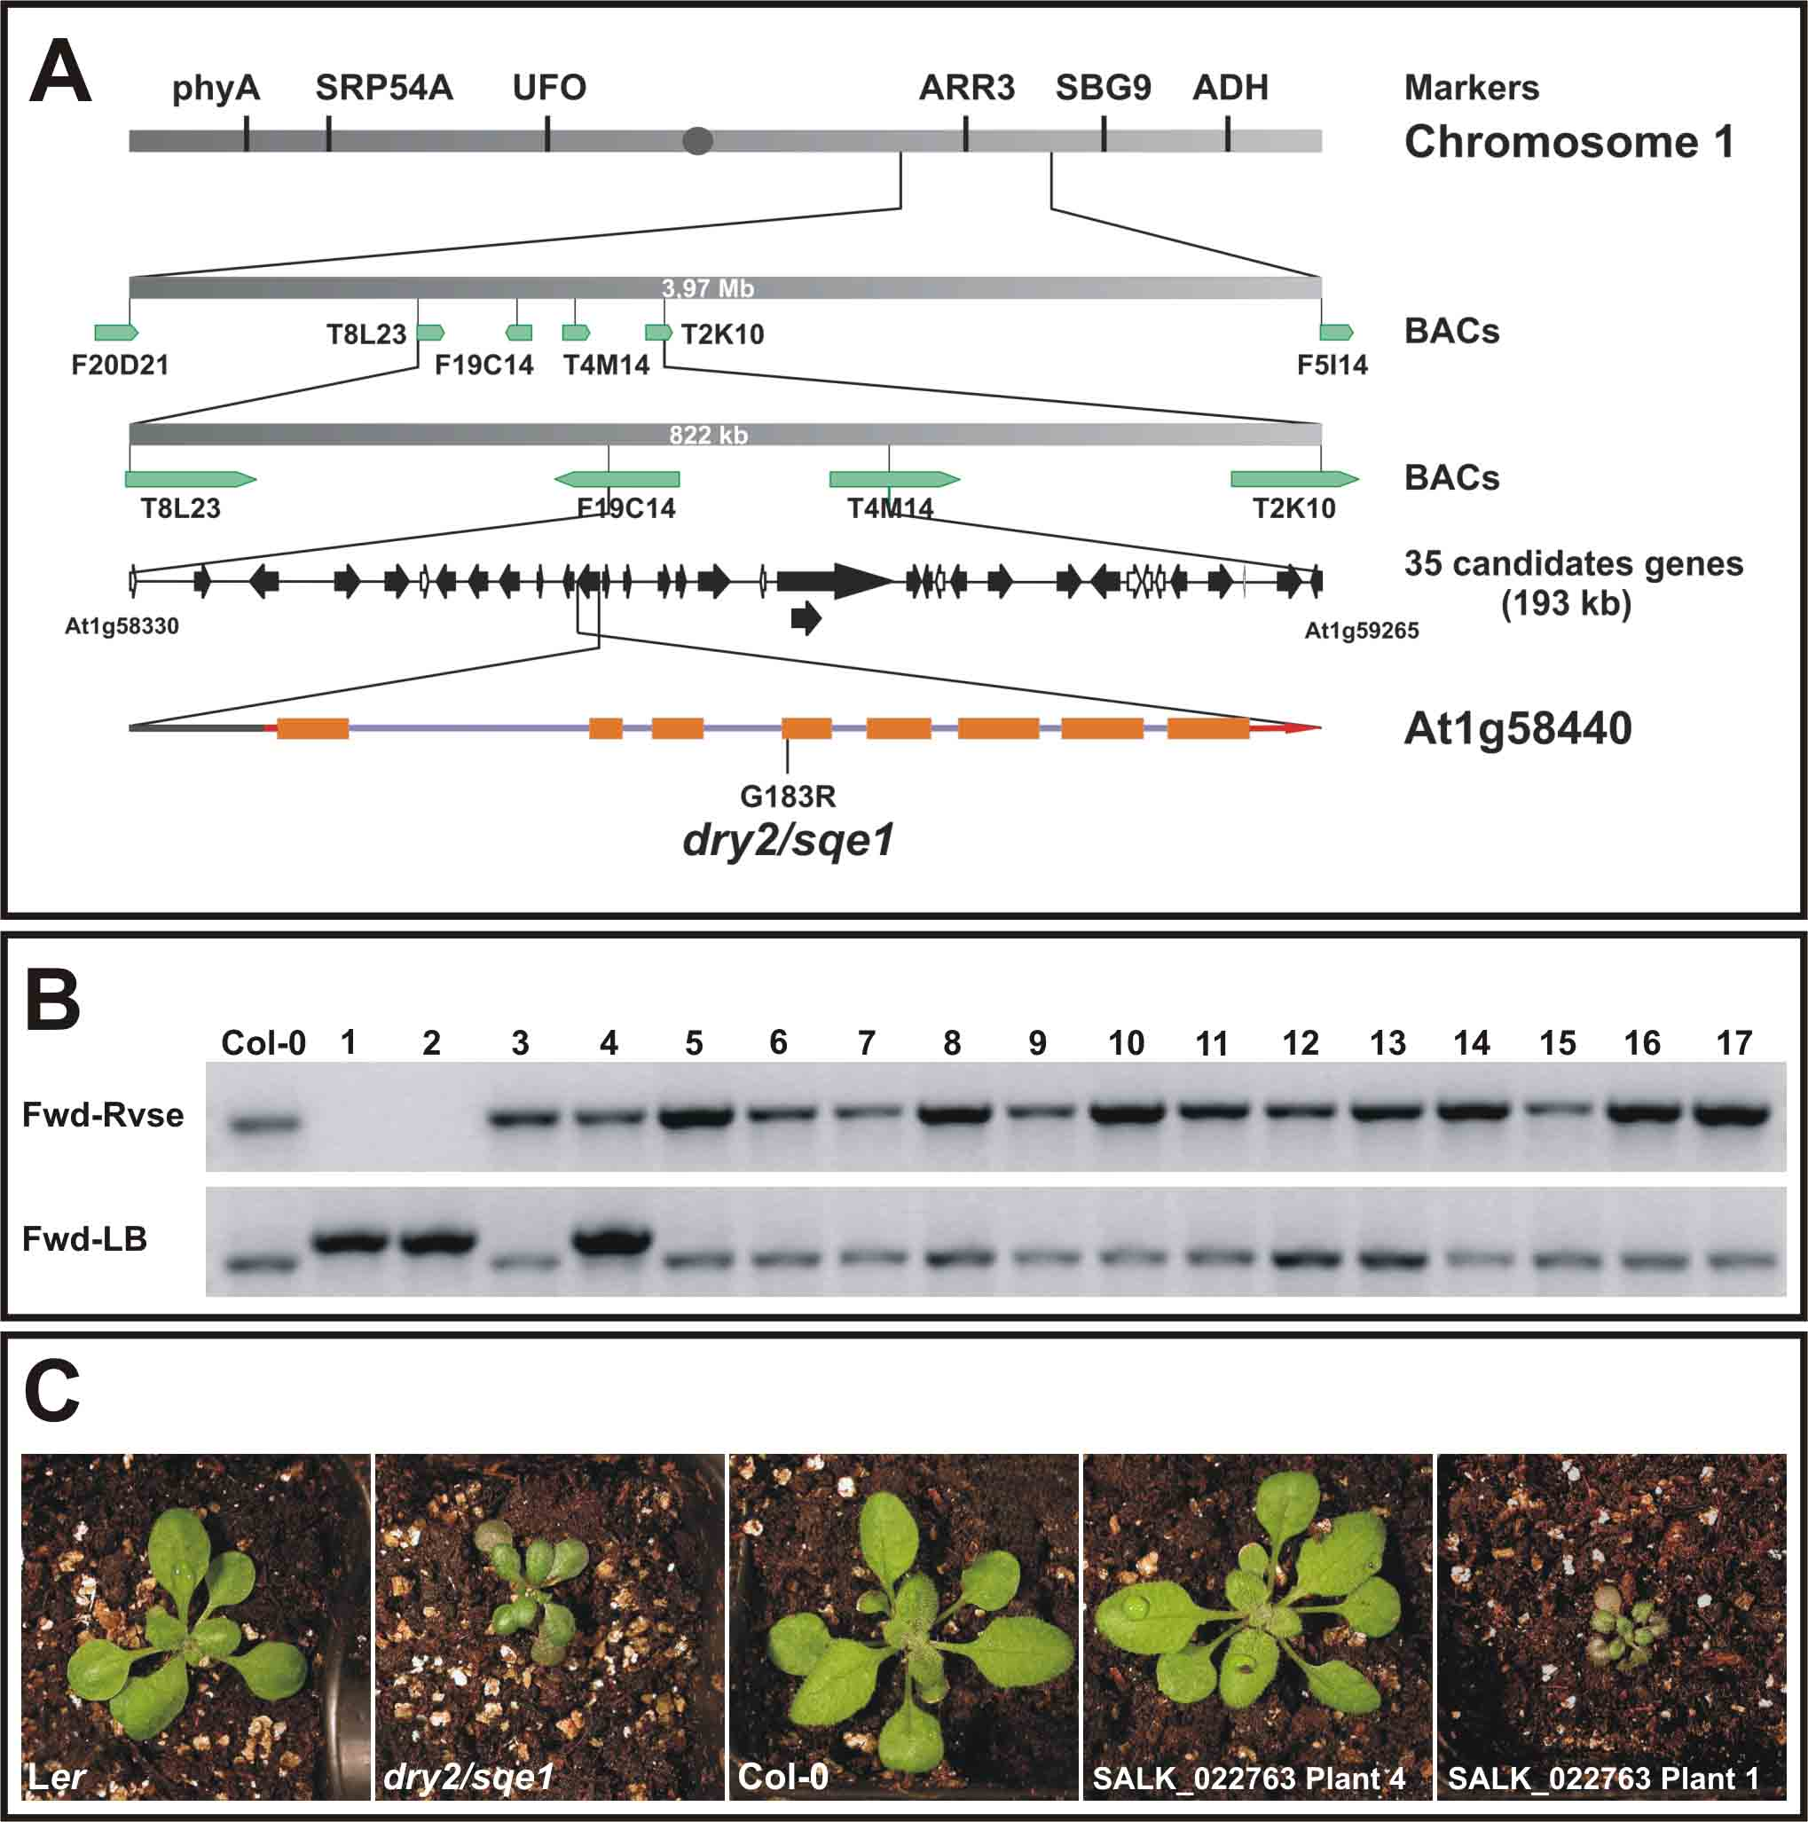
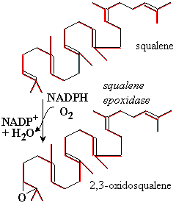
Drought sensibility is caused by sterol profile modification
Squalene
epoxidase
Glycine Arginine (G183R) reduce the activity more than 80 %
Pose et al. 2009 Plant Journal 59:63–76
Notes:
Mutation is the enzyme of the melavonate route affecting the initial steps of steroids biosynthetic pathway, interestingly the plants have residual activity of the enzyme avoiding lethal phenotype previously observed in the null mutants of this enzyme.

Slide 5
Membrane dynamic is affected in dry2 mutant
Ler
dry2
di-4-ANEPPDHQ
(ANEP)
FM4-64
Internalization of probes in bulging and matures root hairs

Slide 6
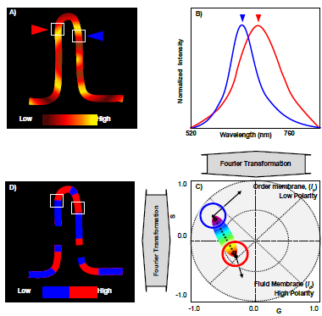
Spectral phasor is a good tool for analyzing the membrane dynamic in vivo
Water
Notes:
Time and intensity of fluoresence of probe was analysed pixel by pixel and use a fourier transformation

Slide 7
Membrane fluidity is affected in dry2 mutant

Slide 8
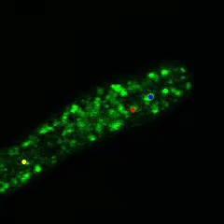
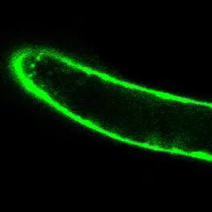
Movement of intracellular membrane vesicles in root hairs
Ler
dry2
Di-4-ANEPPDHQ
(ANEP)

Slide 9
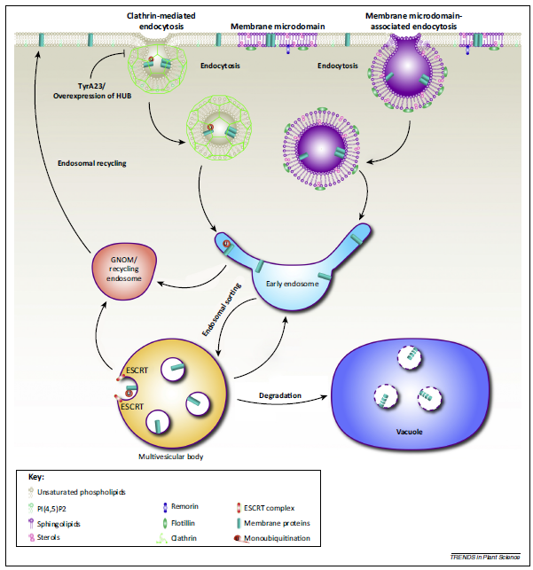
Microdomains are critical for traffic of proteins with role in osmotic stress tolerance
Stress-related
proteins
Fan et al. 2015
Trends in Plant Science 20: 6
Ongoing activity
Soluble and membrane proteomics of root hairs enriched samples of plant under control and osmotic stress conditions

Slide 10
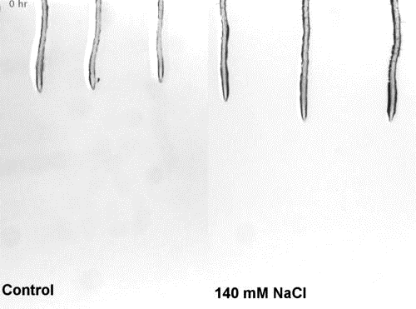
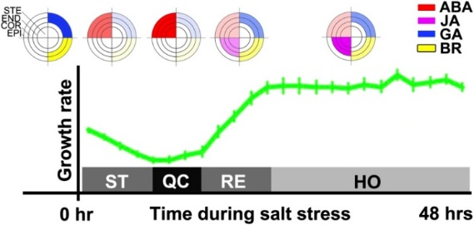
Salt stress root growth recovery includes a quiescent state, root meristem deformation and new growth homestasis
Geng et al., 2013 Dinneny Group

Slide 11
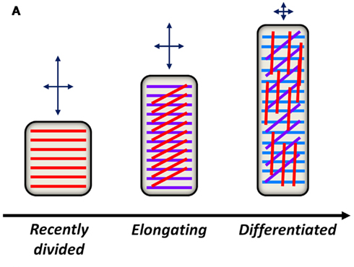
Cell wall controls time and orientation of cells expansion
Col-0
cesa3
Caño-Delgado et al., 2000
Orientation of the cellulose microfibrils along developmental zones of the root.
Wallace et al., 2012
Notes:
COBRA facilitates cellulose crystallization from the emerging β1-4-glucan chains by acting as a "polysaccharide chaperone."

Slide 12
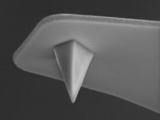
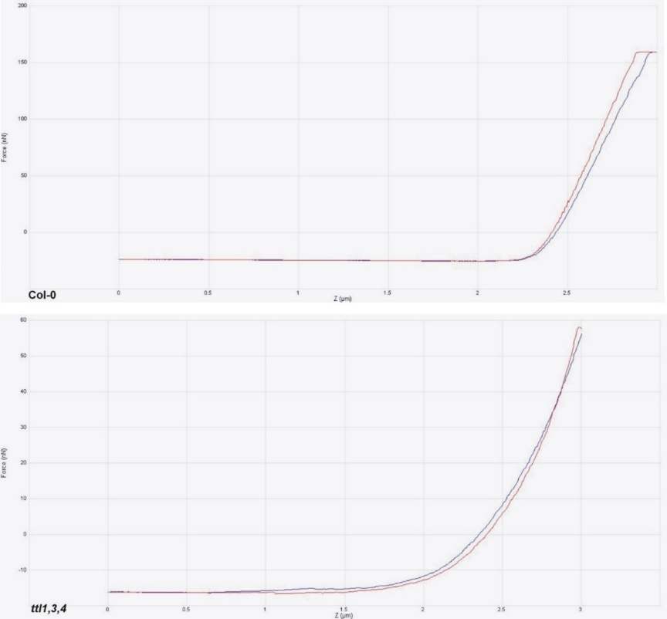
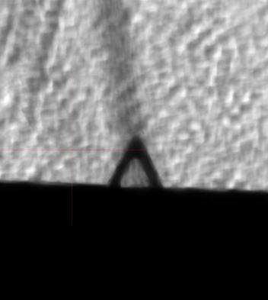
Atomic force microscopy: physical propierties of cell wall
Tip DPN 10 (Silicon Nitride)
Cantilever: Triangular
Elastic constant of Cantilever: 0.35 N/m
Length of Cantilever: 175 micras
Type of tip: Pyramidal
Radius of the tip: 20 nm
Cantilever frecuency 1 Hz
Measures were obtained in roots of living seedlings in fluid.
We obtained 150 curves/seedling, we measure three seedlings per treatment. Three replicas of the experiment were done.

Slide 13
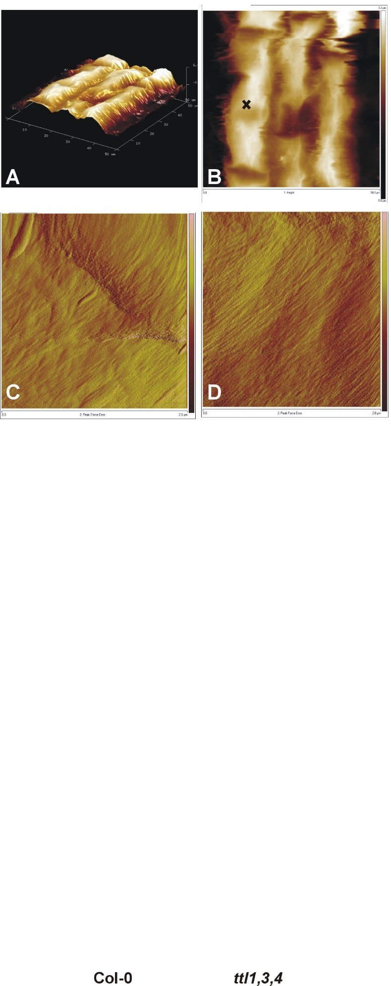
Cell wall physical analysis performed in root elongation zone on living cells
Col-0
ttl1,3,4

Slide 14
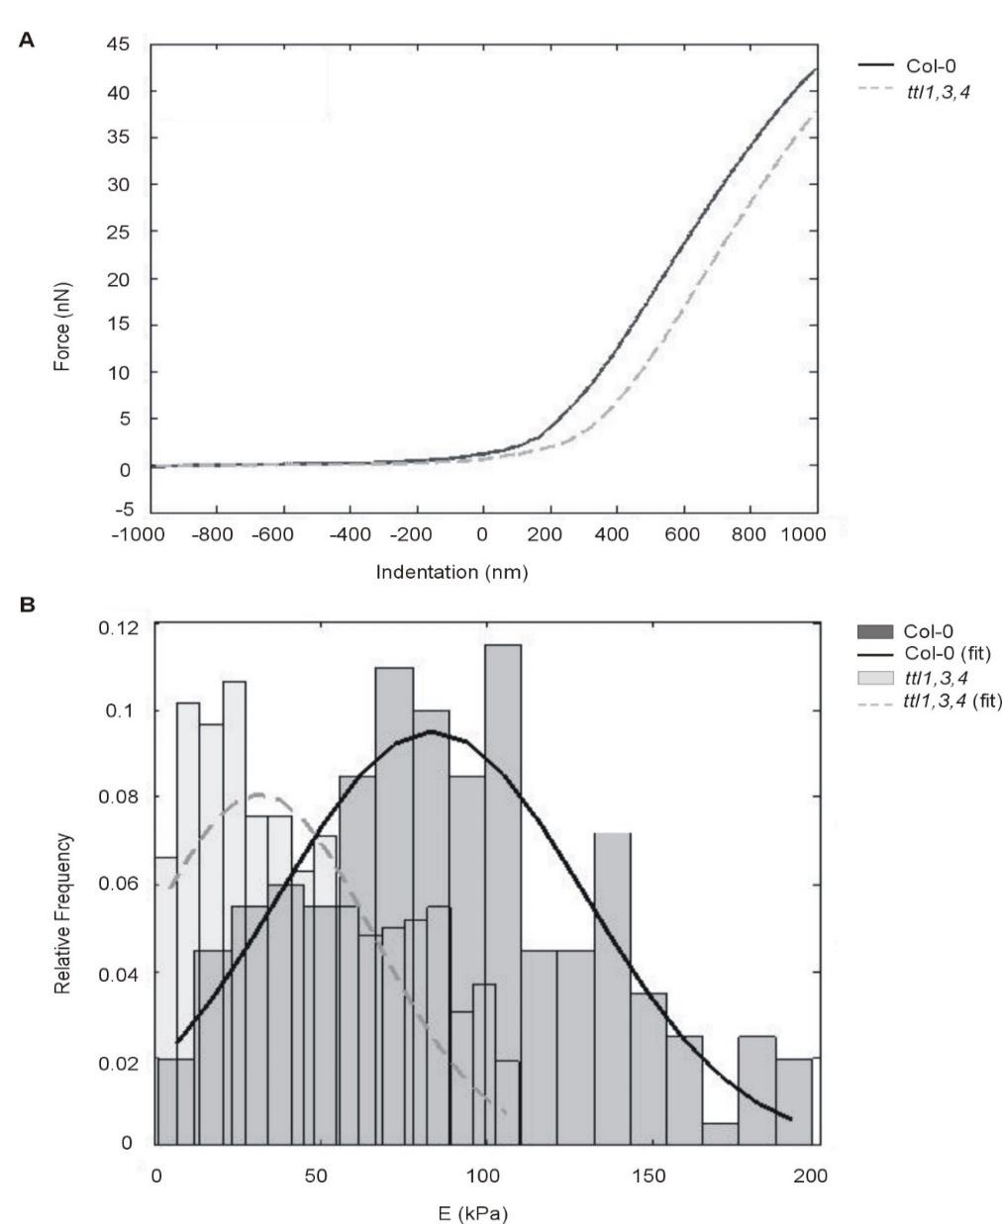
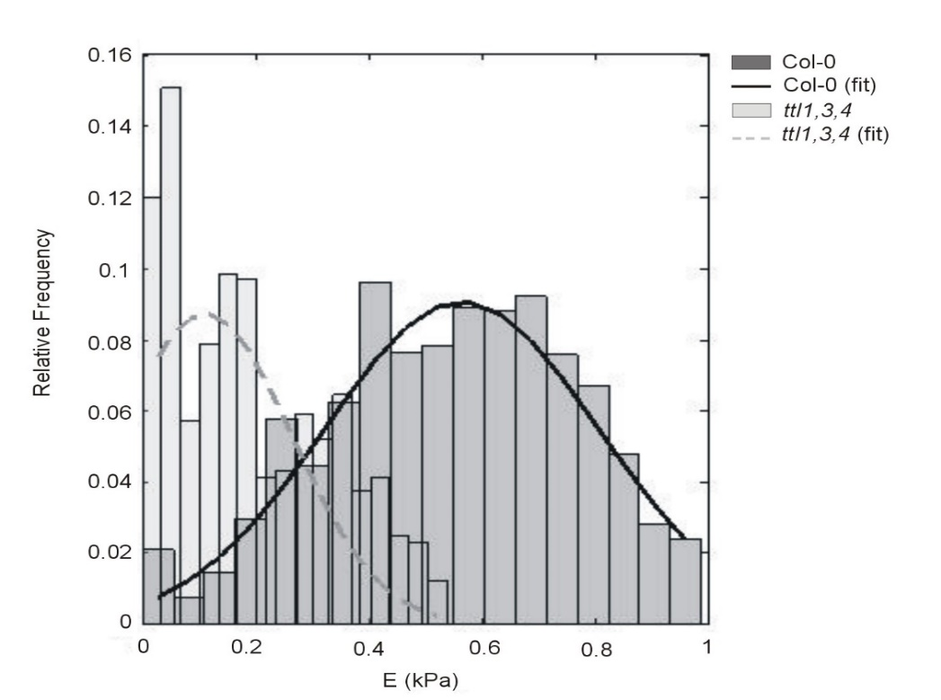
Under control condition Col-0 cell walls of elongation zone cells are harder and more plastic than ttl1,3,4 cell walls

Slide 15
Physical properties in response to osmotic stress indicate changes in quantity, quality and distribution of cell wall components
 | Young’s modulus (kPa)
Condition | Col-0 | ttl1,3,4
Control | 88 ± 44 ª | 43 ± 29 ^{b}
400 mM mannitol | 167.9 ± 46.4 ^{c} | 35.9 ± 21.4 ^{d}
 | Plasticity index
Condition | Col-0 | ttl1,3,4
Control | 0.58 ± 0.0044 ª | 0.12 ± 0.0044 ^{b}
400 mM mannitol | 0.21 ± 0.0043 ^{c} | 0.26 ± 0.0042 ^{c}
 | Work of the adhesive force by area (J/m⁻²)
Condition | Col-0 | ttl1,3,4
Control | 1.25 x 10⁻⁶± 0.13x 10^{-6 a} | 5.97 x 10⁻⁷± 0.42x 10^{-7 b}
400 mM mannitol | 1.84 x 10⁻⁶± 0.009x 10^{-6 c} | 7.98 x 10⁻⁶± 0.16x 10^{-6 d}

Slide 16
Roughness of cell wall surface is increased in ttl mutant
Col-0
ttl1,3,4
 | Col-0 | ttl1,3,4
1D PSD | 39137 nm³ | 24020 nm³
1D Isotropic PSD | 0.00933 nm³ | 0.00572 nm³
2D Isotropic PSD | 37310 nm4 | 22899 nm4
Equivalent RMS | 962 nm | 756 nm

Slide 17
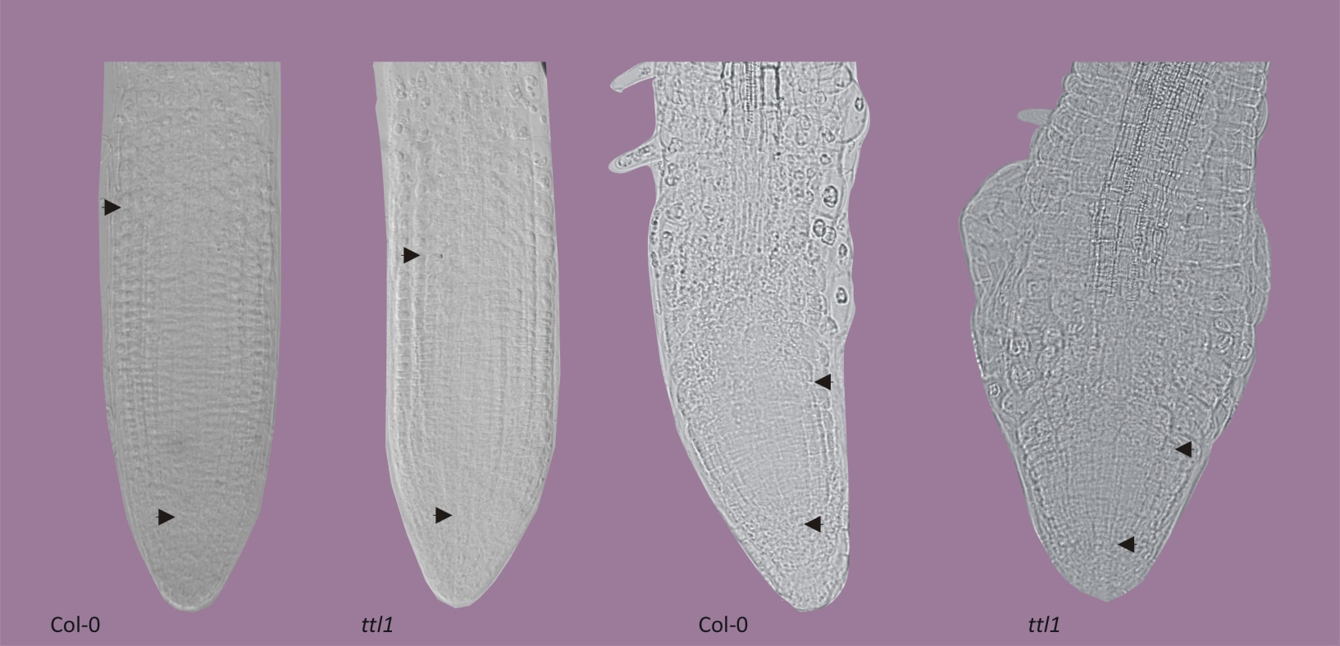
Osmotic stress reduced length of proximal meristem and induce a noteworthy swelling in ttl1 mutant roots
Control
(-0.4 MPa)
Mannitol 400 mM
(-1.2 Mpa)

Slide 18
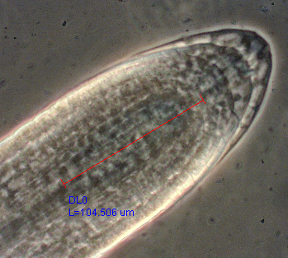
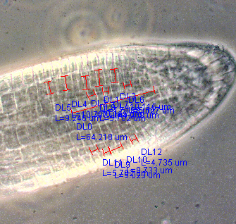
ttl1 and ttl1,3,4 mutants have smaller proximal root meristem with wider cells than Col-0
Col-0
ttl1
20 µm
20 µm

Slide 19
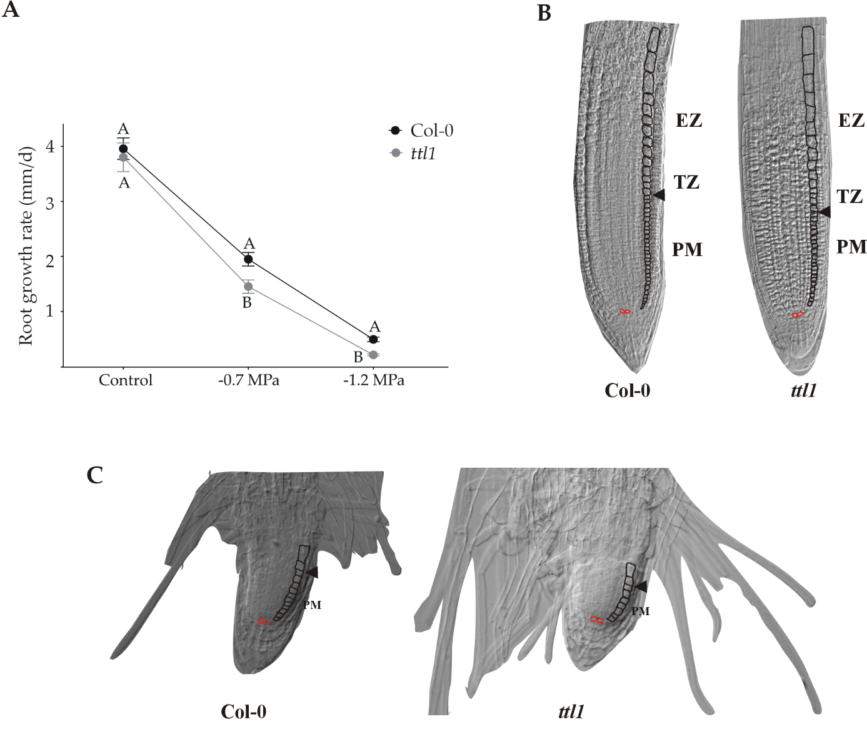

Slide 20
Meristem cells dynamic of ttl1 under osmotic stress
Growth parameters of the PM determining root growth | Control |  | -0.7 MPa
 | Col-0 | ttl1 | ttl1
Cell production rate (cell/h) | 100 % | 93 % | 82 %
Length of the Cell Cycle (h) | 100 % | 80% | 69 %
Cell elongation rate in the PM (µm/h) | 100 % | 130% | 91 %
Average time between each cortical cell living to enter TZ and EZ (h) | 100 % | 108% | 122 %
Table 2. Growth parameters in the PM of Col-0 and ttl1 roots grown in control and osmotic stress conditions.
Values are expressed as a percentage relative to wild type seedlings grown on the same conditions.

Slide 21
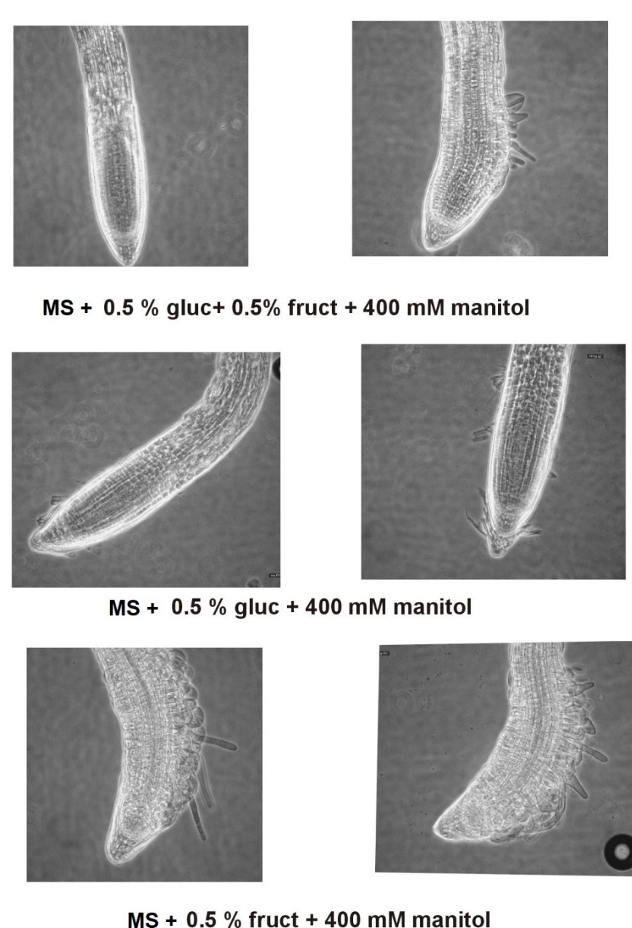

Col-0
ttl1

Slide 22
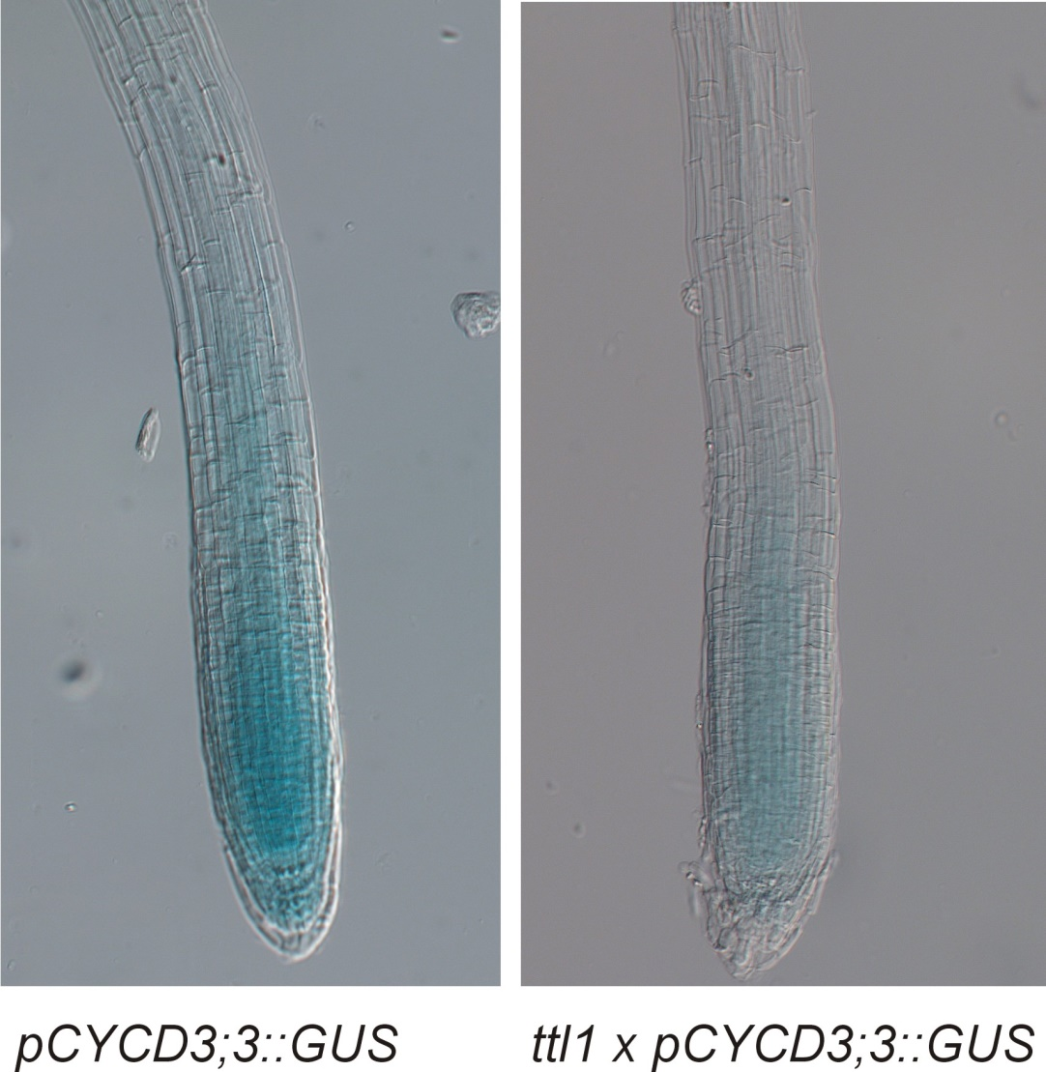
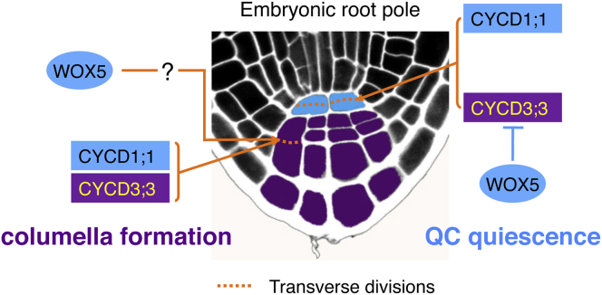
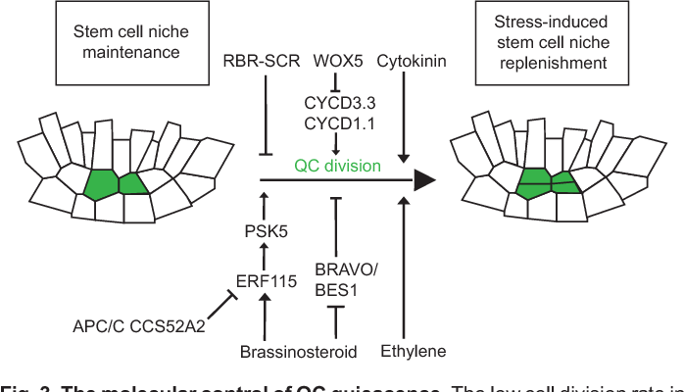
Reduced expression of cyclin would be affecting the cell division capacity during root stress recovery in ttl1
Col-0
ttl1
Forzani, Cet al H. (2014).. Current Biology, 24(16), 1939-1944. https://doi.org/10.1016/j.cub.2014.07.019
Gaillochet and Lohmann
Development (2015) 142, 2237-2249 doi:10.1242/dev.117614

Slide 23
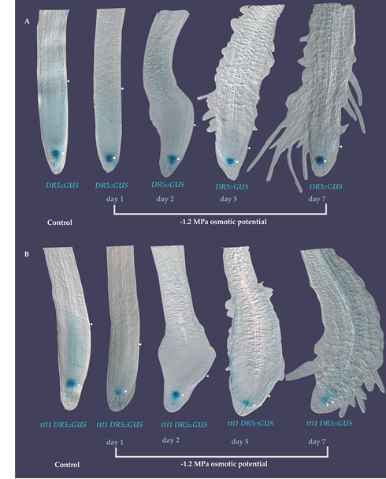
Auixn homeostasis is altered in the mutant affecting cell wall dynamic

Slide 24

Transcription of Cesa1 and Cesa3 is affected in ttl1
Col-0 ttl1 prc1-1 ttl1 x prc1-1

Slide 25
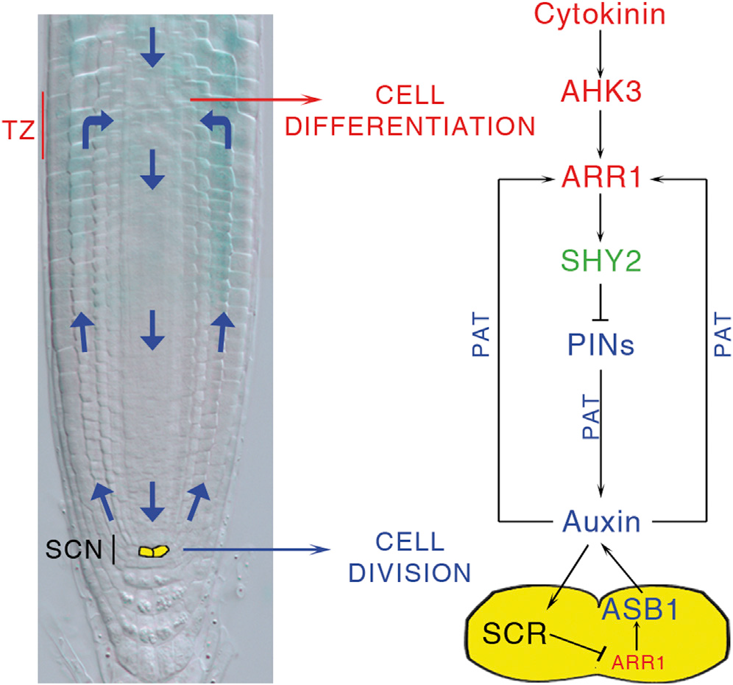
To maintain root growth under stress conditions is required coordinated activity of stem cell niche of mother cell and progeny differentiation
Moubayidin et al., 2013
Notes:
SCR acts in the QC to control, at the same time, stem cell activity and the differentiation of their progeny by cell-autonomously preventing expression of the cytokinin response regulator ARR1 in the QC, and non-cell-autonomously controlling ARR1 expression in the TZ via auxin.
Ah3 mutant enlarged meristem and longer roots…delayed differentiation
Mutation in the SCR gene results in meristem consumption and arrested root growth a few days after germination (Figure 1B), due to defective QC and stem cell activities
It is important to note that the ahk3-3;scr-1 double mutant still displays an undivided ground tissue layer (Figure 1F) (Di Laurenzio et al., 1996) and a lack of protoxylem cells characteristic of the scr-1 mutant (Figure S1B) (Carlsbecker et al., 2010), suggesting that its role in stem cell regulation is independent
of its developmental role in these tissues.
In conclusion, we propose a model in which the SCN organizer not only controls division of the surrounding stem cells (van den Berg et al., 1997) but also regulates the differentiation of the transit-amplifying cells in the TZ. QC activity depends on SCR (Sabatini et al., 2003), which suppresses ARR1, thus titrating auxin production via the ASB1 gene. Auxin produced in the QC not only controls stem cell division activity by an as-yet-unknown mechanism but at the same time acts as a long-distance signal to fine-tune the level of ARR1 transcription in the TZ, thus controlling the rate of differentiation. In this way, a single gene, SCR, regulates the spatial coordination between stem cell division and differentiation, ensuring coherent root growth.

Slide 26
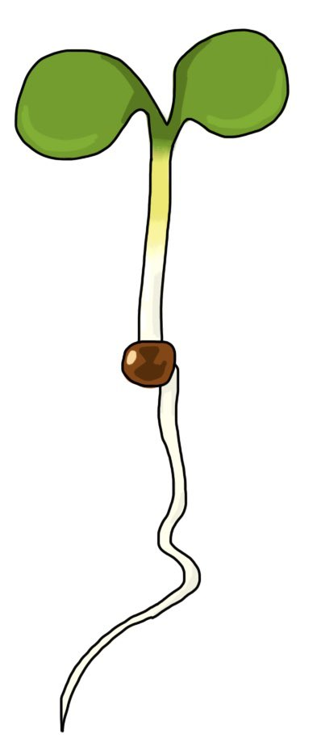
No swelling phenotype is observed in ttl1 when the root is grown under a gradient osmotic stress
[NaCl]
[mannitol]
0 mM
0 mM
230 mM
450 mM
Ongoing activities
RNAseq of proximal meristem under control and somotic stress (shock and gradient osmotic stress conditions)
Cell-specific traductome analyisis
Vesicle trafficking
Heat map hardenesss of cell wall
Notes:
Las células en crecimiento se caracterizan por una presión de turgencia de entre 0.3 a 1 MPa
El modulo elástico de células en crecimiento ha sido reportado en el entorno de 0.1 a 1 Mpa
At the individual-cell level, growth is regulated by turgor pressure and the rate of cell wall loosening. The growth rate of a root drops immediately after transfer to hyper-osmotic media largely due to the escape of water from the cell and the reduction in turgor pressure (Shabala and Lew, 2002; Geng et al., 2013). Interestingly, while turgor pressure can be restored rapidly through an increase in the concentration of osmolytes in the cell, a process termed osmotic adjustment (Beauzamy et al., 2014), growth rate generally recovers at a much slower pace. Depending on the strength of the applied stress, cells in the elongation zone may enter a quiescent stage before their growth rate is recovered (Geng et al., 2013).

Slide 27
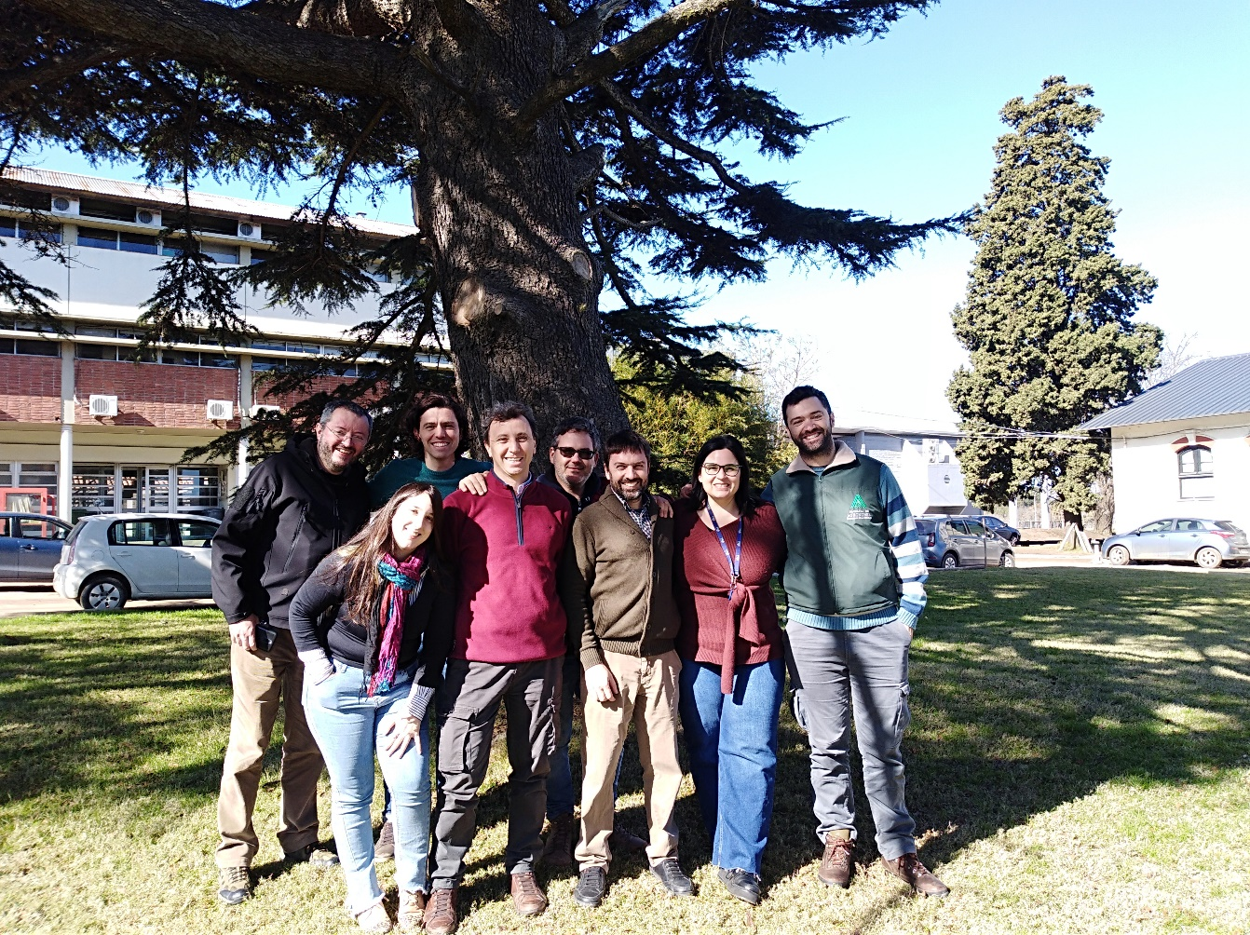
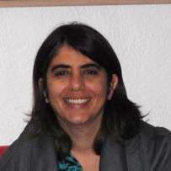
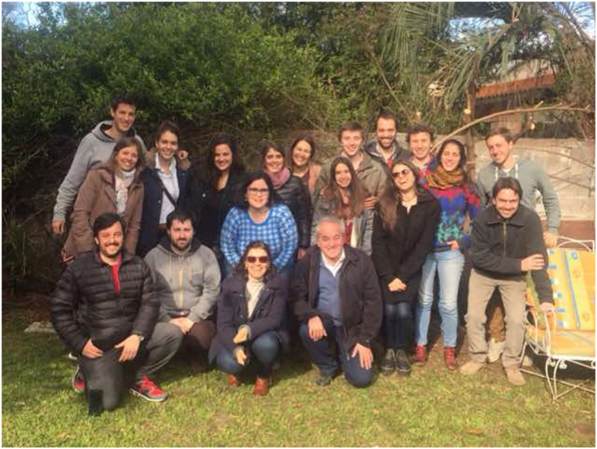




Mariana Sotelo-Silvera
UdelaR Uruguay
Leonel Malacrida
Hospital de Clinicas
UdelaR/ Inst. Pasteur Montevideo

