Slide 1
Effect of operational parameters on the gas composition from self-sustaining smoldering of biomass
Martin Torres Brunengo¹ and Luis Yermán²
1- Area Fisicoquímica, DETEMA, Facultad de Química, Universidad de la República, Gral. Flores 2124 CC 1157, 11800 Montevideo, Uruguay
2- School of Civil Engineering, The University of Queensland, Brisbane, 4072, Australia
Notes:
Good morning, everyone.
My name is Martin Torres, and I am a chemical engineer with a doctorate in chemistry. I am currently working at Universidad de la Repubica- Faculty of chemistry.
Today, I will present the work named "Effect of operational parameters on the gas composition from SSS of biomass," co-authored by Luis Yerman, who is a research fellow of the University of Queensland in Australia.
This work was carried out during a three-month posdoc internship at UQ in 2022, in the school of civil engineering-Fire group.

Slide 2
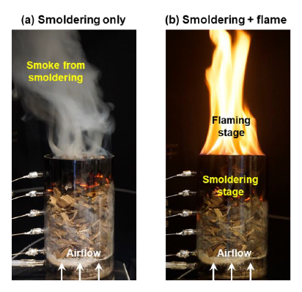
SMOULDERING
Highly energy-efficient, low-temperature and flameless combustion that burns slowly
historically been on the topic of fire safety hazard
Recently been applied to treatment of soil and destruction of wastes with high moisture content
provides potential for the production of value-added products
Images extracted from: Chen, Yuying, et al. Fuel Processing Technology 237 (2022): 107453.
Notes:
So, the audience may wonder: what is smoldering combustion?
Smouldering combustion is a highly energy-efficient, slow-temperature, and flameless form of combustion that propagates through a porous fuel.
Research in smouldering combustion has historically been on the topic of fire safety hazard. Recently, has been applied to treatment of soil and destruction of wastes with high moisture content.
It is important note that self-sustaining smouldering involves the thermochemical destruction of wastes in low oxygen atmosphere, this provides potential to produce value-added products

Slide 3
It does not require additional fuel after ignition.
It is a highly energy-efficient process even when the fuel has a low higher heating value.
Could be considered as self-sustaining smouldering (SSS) up to 75-80% moisture content
MAIN ADVANTAGES OF SMOULDERING
Notes:
And, what are its main advantages?

Slide 4
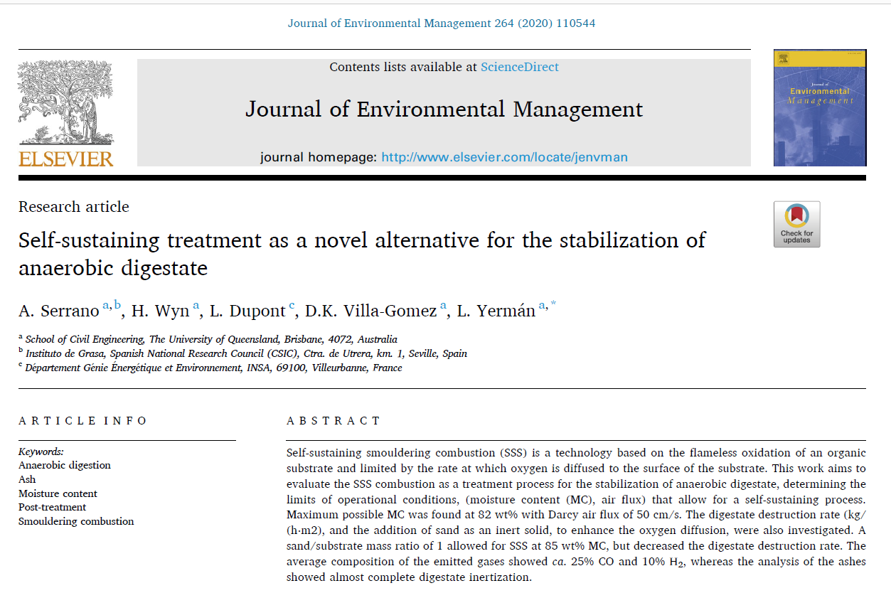
Which is the background that aims this work?
SSS as a possible alternative for the treatment of anaerobic digestate.
SSS is suitable to accomplish full digestate inertization.
Assessment of two main operational parameters: Darcy air flux and biomass moisture content, Serrano et.al found the threshold limits where SSS is possible
Gas contains as main component CO₂ (60 to 70%), in addition, CO and H₂ were presented in percentages around 25 and 10%, respectively.
Notes:
This research based on the work performed by Serrano et al., where they studied the use of SSS for stabilizing anaerobic digestate.
SSS effectively inertized digestate, destroying pathogens, even with high moisture content (up to 85%).
Two parameters were evaluated: Darcy Flow and Moisture content, focusing on threshold limits for SSS of digestate mixed with coco coir.
Gas composition analysis showed CO2 as the main component (60-70%), with CO and H2 present at around 25% and 10%, respectively.
This study demonstrates SSS as a viable option for stabilizing anaerobic digestate, providing insights into operational parameters and gas composition.

Slide 5
Objective of this work
Evaluate the sensitivity of the biomass moisture content and the air flux on the gas product composition during the smouldering of anaerobic digestate mixed with agricultural waste.
Notes:
So, in aim of this, this work Evaluate the sensitivity of the biomass moisture content and the air flux on the gas product composition during the smouldering of anaerobic digestate mixed with agricultural waste.

Slide 6
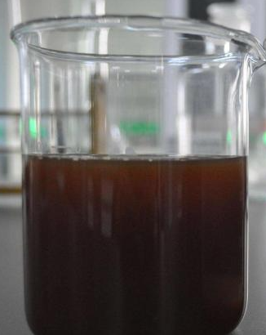
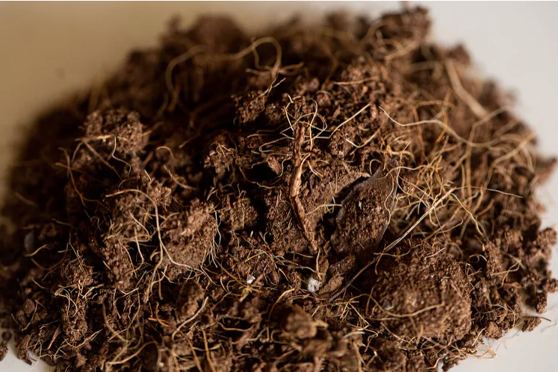
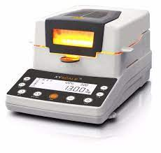
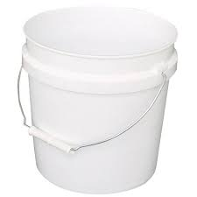
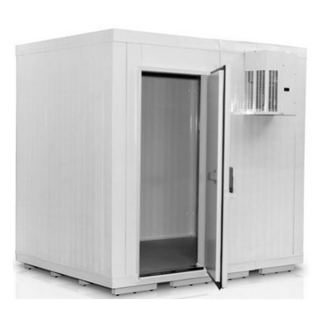
Experimental design
sample preparation
Experiment | MC_{wb} (%) ª | DIG/UCC (g/g) ^{b} | Darcy flux (cm/s) ^{c}
1 | 50 | 0.2 | 3.7
2 | 50 | 0.2 | 7.3
3 | 50 | 0.2 | 14.6
4 | 60 | 0.5 | 3.7
5 | 60 | 0.5 | 7.3
6 | 60 | 0.5 | 14.6
7 | 70 | 1.0 | 3.7
8 | 70 | 1.0 | 7.3
9 | 70 | 1.0 | 14.6
Digestate (DIG)
Coco Coir (UCC)
Moisture analyser
(MC)
ª ± 1% given in wet basis, ^{b} ± 0.1 g/g ,^{c} ± 0.3 cm/s
DIG= 99.2 %
UCC= 40.6 %
UCC
kept at 4°C
Check MC
water balance to adjust MC with the amount of each biomass
DIG
storage in buckets
Notes:
The proposed experimental design consisted of carrying out 9 tests (each with a duplicate), changing the moisture content of the biomass mixture and the linear air velocity, also known as the Darcy flux.
The humidity of the raw biomass samples was monitored using a moisture analyzer to adjust the moisture content of the mixtures.
The MC of the mixtures was then determined by calculating a water balance and measuring the appropriate mass of each biomass. The mixture MC was checked with the moisture analyzer; if the value was correct, the sample was stored in buckets and kept in a refrigerated chamber at 4 C until the experiment was performed.

Slide 7
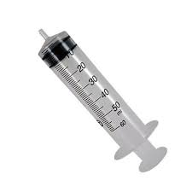
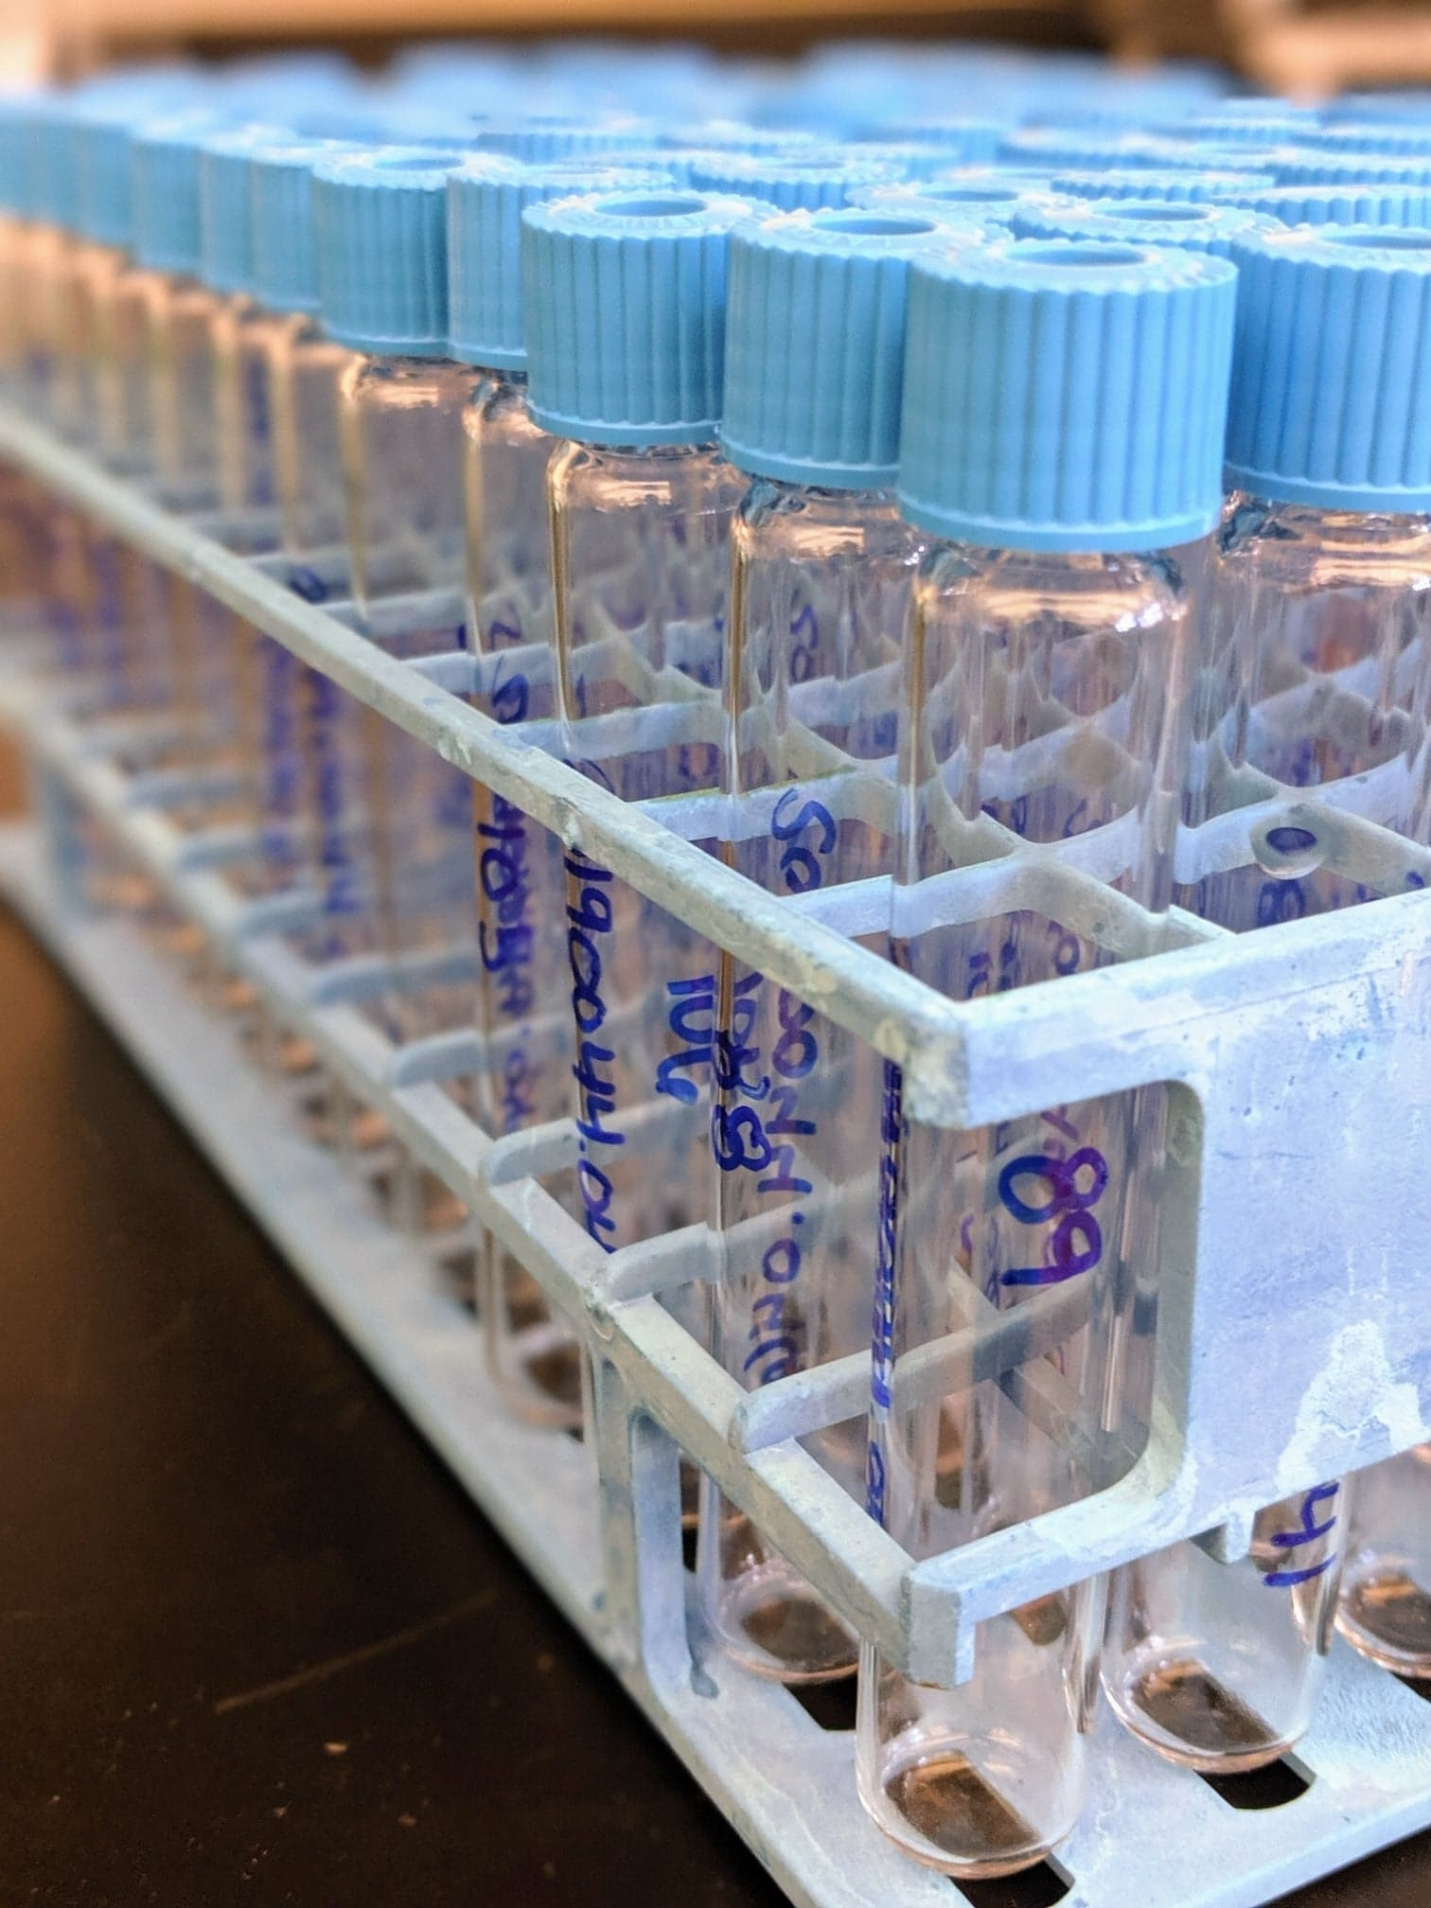
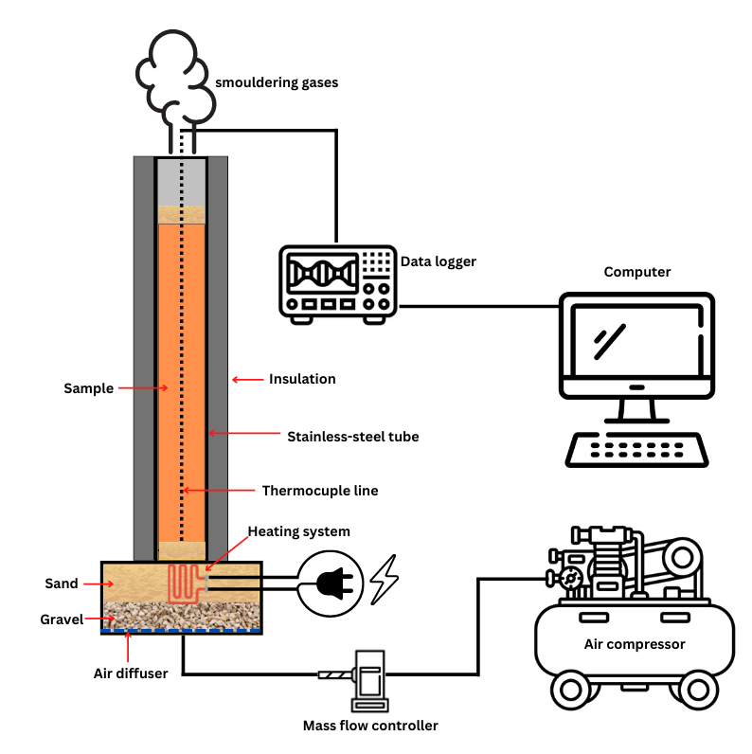
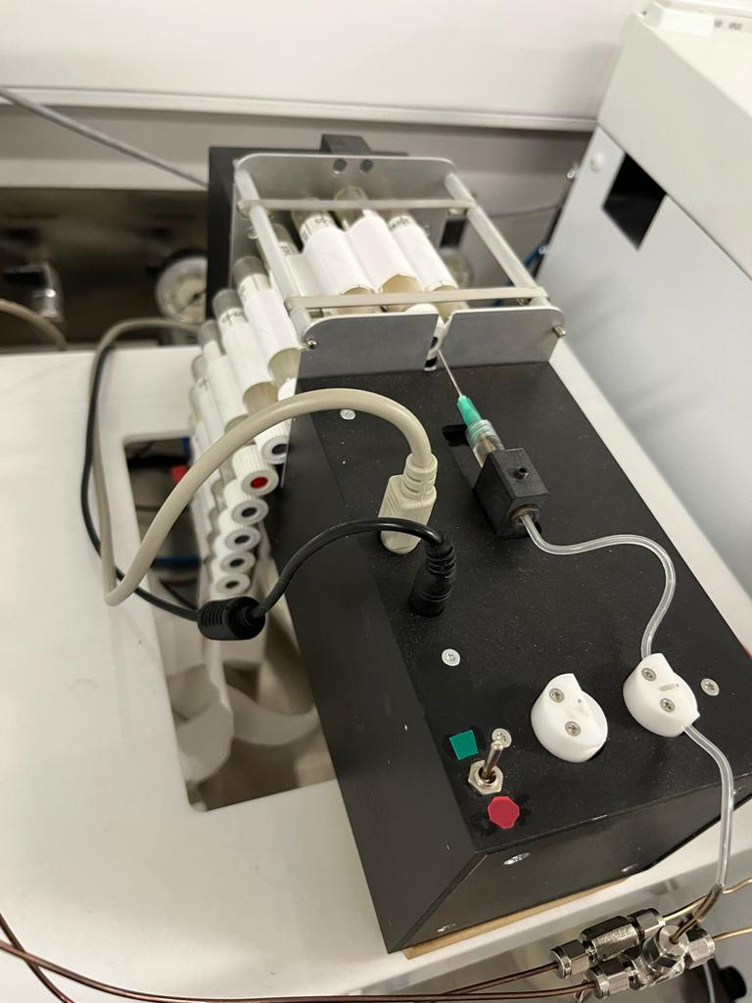
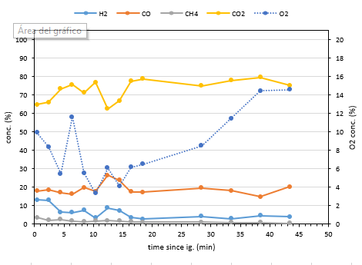
SMOULDERING REACTOR SET-UP
Gas cromatography analysis
Airtight vials
Data analysis
Notes:
This figure shows a smouldering reactor, it consists of a insolated stainless tube, where a termocuple line is placed centered into the tube. The termocuples record the temperatures by means of a data logger connected to a computer.
The sample is placed into the reactor, and a heating system supplies energy until the temperature of the thermocouple located close to the heating system reaches 250 C, at this moment, the power supply is cut down and the mass flow controller is turned on.
When gas starts to coming out from the top of the reactor, gas samples were taken every 2-3 min, placed into vials and analyzed by gas chromatograpy.

Slide 8
RESULTS AND DICUSSION- Gas composition (N2 free)
H₂
CH₄
CO
CO₂
When comparing the air flows at a same MC, the higher the aiflow, the more H₂ and CO are produced, except to CH₄
When comparing the MC between them at a same air flow, there is not possible to see clearly differences between 50 and 60 % and 60% and 70% , but 50 and 70 % shows differences on the gas composition when high darcy flux are used.
However, a darcy flux of 14.6 cm/s and MC of 50 % turns out being the most promising airflow and MC in term of gas content
Notes:
From this analysis, H2, CO, CH4 and CO2 content were quantified.
When comparing the air flows at a same MC, the higher the aiflow, the more H₂ and CO are produced, except to CH_{4.} In the case of CH₄, no significant differences were observed
When comparing MC at the same airflow, there is not possible to see a clear trend. Although 50 % an 70 % show clear differences in its gas compositions when a darcy flux of 14.6 cm/s is used.
So that, a darcy flux of 14.6 cm/s and MC of 50% turns out being the most promising airflow in term of gas content

Slide 9
RESULTS AND DICUSSION- Temperature and High heating value of gases
Average maximum temperature (ºC) reached in SSS experiments
Darcy Flux (cm/s) | Moisture content (%)
 | 50% | 60% | 70%
3.7 | 871 ± 22 | 708 ± 12 | 645 ± 50
7.3 | 881 ± 20 | 781 ± 21 | 739 ± 47
14.6 | 960 ± 47 | 922 ± 44 | 909 ± 36
$$HHV \left(\frac{MJ}{m^{3}}\right)=\frac{12.78}{100} \left(\% H_{2}\right)+\frac{12.64}{100} \left(\% CO\right)+\frac{39.87}{100} \left(\% CH_{4}\right)$$
Enhance endothermic chemical reactions
Material reforming
$C_{n}H_{m}+nCO_{2}→2nCO+\frac{m}{2} H_{2}$
if n=3 and m=8 , ΔH°= 644.8 kJ/mol
Bonduard
$$C+CO_{2}→2CO \text{Δ}\text{H}\text{°}\text{= }\text{172 }\text{kJ}\text{/}\text{mol}$$
Methane decomposition
$CH_{4}→C+2H_{2}$ ΔH°= 74 kJ/mol
Compared to other works (Wyn, Hons K., et al. (2021)), the HHV obtained in this work is approximately 3.5 times higher than the previous reported for sole UCC
Steam reforming
$CH_{4}+H_{2}O→CO+3H_{2 }$ ΔH°= 206 kJ/mol
Notes:
The table shows the average temperature calculated for each experience. A darcy flux of 14.6 cm/s gave the higher temperatures.
These behaviour is in accordance with the gas results, and a possible explanation is because higher temperatures enhance endothermic chemical reactions, which gives more CO and H₂.
With the gas composition results, we proceed to calculate the HHV of the gas using the following equation, results are showed in the following figure.
The main differences obtained in the HHV value are due to the variations of CO and H₂.
As a result of this assessment, and in comparison, to the results obtained by Serrano, a boosted gas composition is obtained when using an initial moisture content of 50% and a Darcy flux of 14.6 cm/s, producing a gas with a HHV value of 5.4 MJ/m³ and contents of 15 % H₂, 24 % CO, 1 % CH₄ and 60 % CO₂.

Slide 10
CONCLUSIONS AND PERSPECTIVES
it is possible to improve the composition of the resulting gas controlling MC and airflow
Compared to Serrano et al, the best conditions were a MC of 50% and a Darcy flow of 14.6 cm/s, resulting in a gas with a composition of 15% H₂, 24% CO, 1% CH₄, and 60% CO₂ (free of N₂).
Gas products has a calorific value of 5.6 MJ/m³ under these conditions
These findings describe a proof-of-concept study that shows the potential for using SSS as a technology to optimize the fuel gas composition of biomass by varying its main parameters.
Future work will be focused on performing mass and energy balances to determine whether this process could be considered as SSS or low-cost smouldering

Slide 11
AKNOWLEDGMENTS
Project fundings
Project ANII FCE_2020_161919
Grant MIA 122
Thank you for your attention

