Slide 1
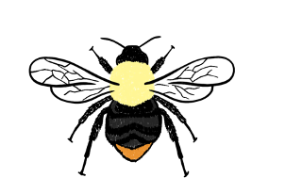
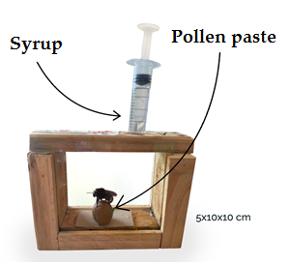
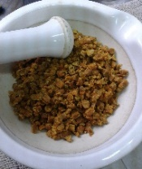
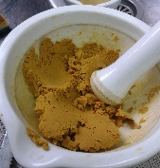
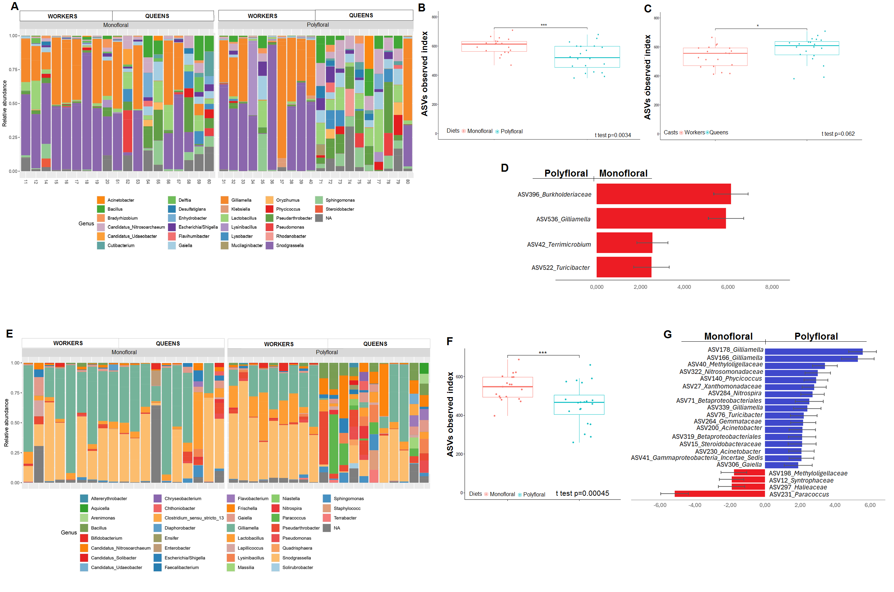
Effect of diet and caste on the gut microbiota of Bombus pauloensis and Bombus bellicosus
Castelli L^{1,2}., Antúnez K¹., Davoine, I³.,Invernizzi C³. & Salvarrey S³.
Laboratorio de Microbiología y Salud de las Abejas, Departamento de Microbiología, IIBCE. Montevideo, Uruguay.
Centro de Investigaciones en Ciencias Ambientales (CICA) IIBCE, Montevideo, Uruguay.
Sección Etología, Facultad de Ciencias. Universidad de la República. Montevideo, Uruguay.
Introduction
Bombus spp. are among the most important wild pollinators in natural and agricultural hábitats ⁽¹⁾. These insects are suffering dramatic declines in their populations. Changes in land use, habitat destruction, nutritional stress and pathogens infections have been associated with those declines ⁽²⁾. As in other species, gut microbiota might play an important role in the maintenance of health ⁽³⁾.
In this study, we examined whether the diet and castes (queen and worker) influenced gut microbiota and the development of pathogen, under laboratory conditions.
Materials and methods
Ten fertilized queens of Bombus pauloensis and 10 of Bombus bellicosus were collected and transferred to the laboratory. They were caged and fed with two different diets ad libitum: monofloral pollen (Eucalyptus grandis) or polyfloral pollen.
Temp: 27-28°C
Hr: 40-60%
2. After the microcolonies were developed, at 5 days, queens and workers from both groups were sampled.
3. Guts were extracted, DNA was obtained
4. DNA was obtained and subjected to 16S rRNA gene sequencing to evaluate the gut microbiota.
1. Experimental design
Results
Diet pollen affected the gut microbiota of B. pauloensis and B. bellicosus.
Monofloral pollen increased the richness of gut microbiota from both Bombus species, mainly increased the Gilliamella sp abundance (Figure B, F and D).
The gut microbiota from different castes of B. bellicosus was different. Queens had more diverse gut microbiota than workers (Figure C).
The presence of pathogens evaluated was not detected in any samples.
Discussion
These results suggest that nutrition influences the abundance key components of gut microbiota in B. pauloensis and B. bellicosus. Those results contribute to the understanding of the influence of agriculture intensification on health Bombus spp. and how it can adapt to different environmental conditions.
References
1. Velthuis and Van Doorn. 2006. A century of advances in bumblebee domesticationand the economic and environmental aspects of its commercialization for pollination. Apidologie, 37: 421-451.
2. Goulson et al., 2015. Bee declines driven by combined stress from parasites, pesticides, and lack of flowers. Science, 347:10.1126/science.1255957
3. Engel, P., Martinson, V. G., Moran, N. A., 2012. Functional diversity within the simple gut microbiota of the honey bee. Proc Natl Acad Sci U S A, 109, 11002-11007

