Slide 1




Ayahuasca’s psychedelic component DMT promotes neuritogenesis in PC12 cells
ISRP conference
March 7, 2025
Dr. mariana pazos
Lab. de Mecanismos de Neurodegeneración y Neuroprotección,
Cátedra UNESCO de Productos Naturales Neuroactivos,
Instituto de Investigaciones Biológicas Clemente Estable
Montevideo, Uruguay

Slide 2
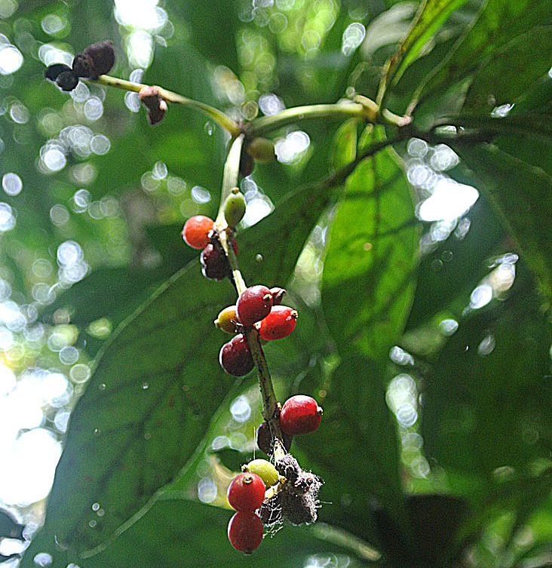






introduction
What we are working on
WE STUDY THE NEURITOGENIC EFFECT OF NATURAL PSICHEDELICS ON PC12 CELLS
P. viridis
Psilocin
Iboga alkaloids
Ayahuasca and its components
B. caapi

Slide 3
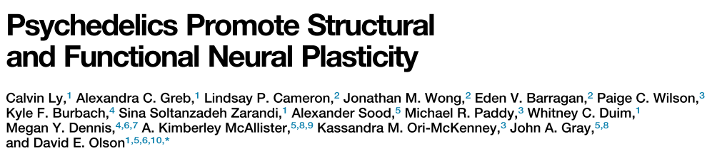

introduction
Context: DMT and its therapeutic potential
Regulates adult neurogenesis in vitro and in vivo
J. A. Morales-Garcia, et al., Transl. Psychiatry 2020, 10, 331.
Anti-AD effects in vivo and in vitro
C. Ly et al., Cell Rep., vol. 23, no. 11, pp. 3170–3182, 2018.
D. Cheng, et el., Alzheimers. Res. Ther. 2024, 3, 1–16.
Modulates innate and adaptive inflammatory responses in vitro
D. E. Olson, J. Exp. Neurosci. 2018, 12, 1–4.
A. Szabo, et al., PLoS One 2014, 9, 1–12.
Neuritogenesis and spinogenesis in rat cortical cultures
Spinogenesis in rat’s PFC
Anti-ischemic properties in rat brain
N. Ye, et al., J. Med. Chem. 2020, 63, 15187–15217;
Í. Szabó, et al., Neuropharmacology 2021, 192, 108612.
C. Ly et al., Cell Rep., vol. 23, no. 11, pp. 3170–3182, 2018.
Increases cell survival against hypoxia in vitro
A. Szabo, et al., Front. Neurosci. 2016, 10, 1–11.

Slide 4
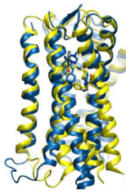
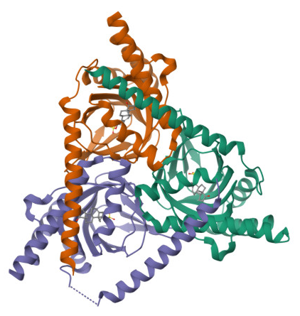
introduction
DMT and its therapeutic potential:
main pharmacological targets
Regulates adult neurogenesis in vitro and in vivo
J. A. Morales-Garcia, et al., Transl. Psychiatry 2020, 10, 331.
Anti-AD effects in vivo and in vitro
C. Ly et al., Cell Rep., vol. 23, no. 11, pp. 3170–3182, 2018.
D. Cheng, et el., Alzheimers. Res. Ther. 2024, 3, 1–16.
Modulates innate and adaptive inflammatory responses in vitro
5-HT_{2A}R
Sigma-1R
D. E. Olson, J. Exp. Neurosci. 2018, 12, 1–4.
A. Szabo, et al., PLoS One 2014, 9, 1–12.
Neuritogenesis and spinogenesis in rat cortical cultures
Spinogenesis in rat’s PFC
Anti-ischemic properties in rat brain
N. Ye, et al., J. Med. Chem. 2020, 63, 15187–15217;
Í. Szabó, et al., Neuropharmacology 2021, 192, 108612.
C. Ly et al., Cell Rep., vol. 23, no. 11, pp. 3170–3182, 2018.
Increases cell survival against hypoxia in vitro
A. Szabo, et al., Front. Neurosci. 2016, 10, 1–11.

Slide 5
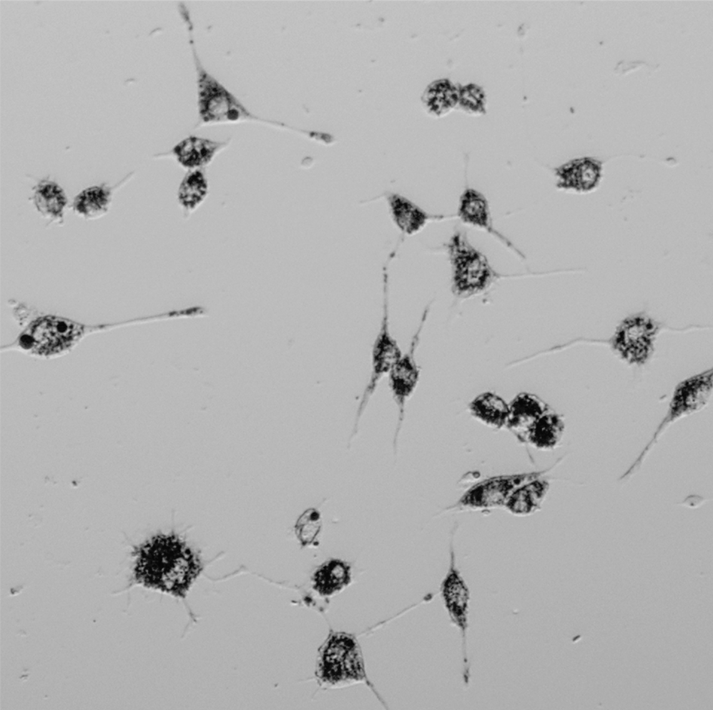
DMT IN PC12 CELL LINE
Neuritogenesis?
PC12 cells

Slide 6
DMT IN PC12 CELL LINE
Well-established cathecolaminergic cell line obtained from a rat pheochromocytoma
Able to synthesize, take up, store and release catecholamines (mainly dopamine and epinephrine).
When stimulated with Nerve Growth Factor (NGF), they differentiate to neuron-like cells (dPC12):
cease division
extend neurites
form synapse-like structures
show electrical excitability properties
PC12 cells
SUITABLE MODEL TO STUDY
Neuronal differentiation
Neurite outgrowth
Molecular mechanisms
Express:
Serotonin 5-HT_{2A}R
Sigma-1 receptor
K. K. Teng, et al., Cell Biol. Four-Volume Set, 2006, pp. 171–176.
L. A. Greene, A. S. Tischlert, Cell Biol. 1976, 73, 2424–2428.

Slide 7
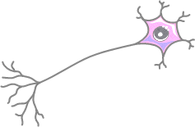
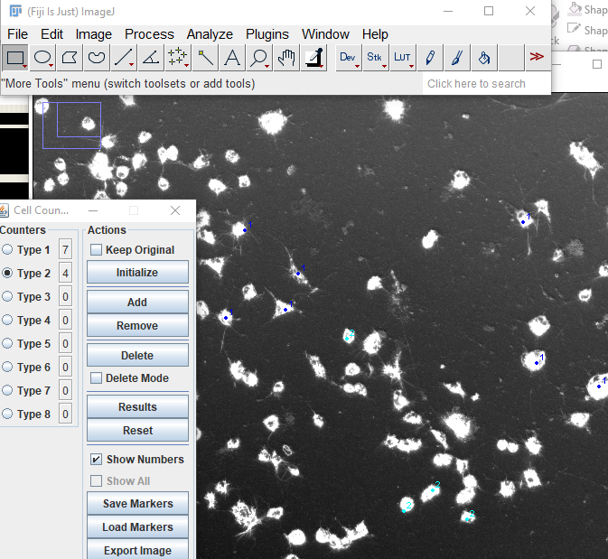
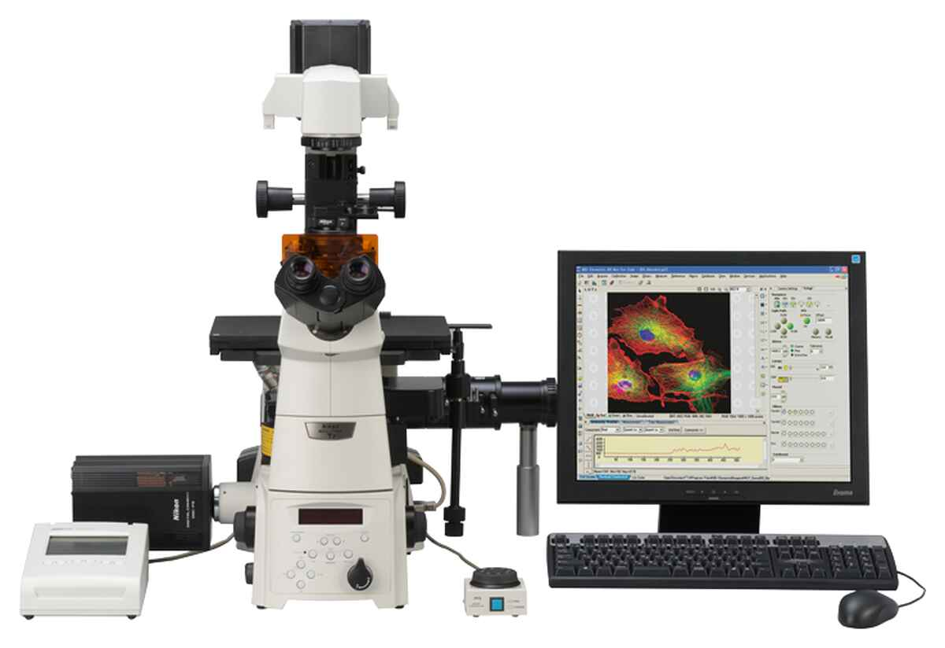
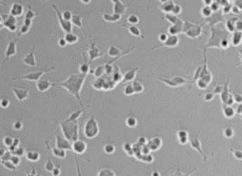
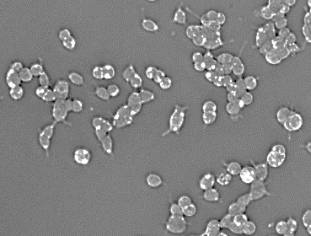
DMT IN PC12 CELL LINE
Effect of DMT on neurite outgrowth
DMT +
↓ NGF,
72h
DMT, 72h
PC12 naive
dPC12
PC12 naive
Cells stained (MTT) and fixed (4% PFA)

Slide 8
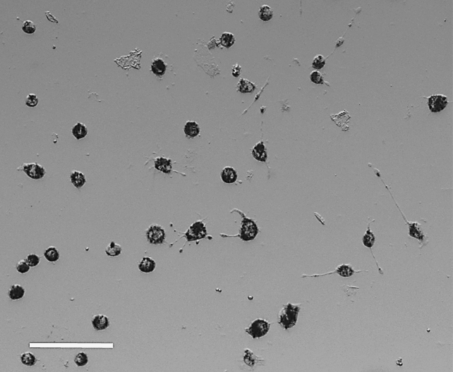
DMT IN PC12 CELL LINE
Effect of DMT on neurite outgrowth
Initial characterization
DMT +
↓ NGF,
72h
DMT shows an additive-like effect with NGF
DMT, 72h
PC12 naive
DMT promotes neuritogenesis in PC12 cells
DMT 5µM
100µm

Slide 9
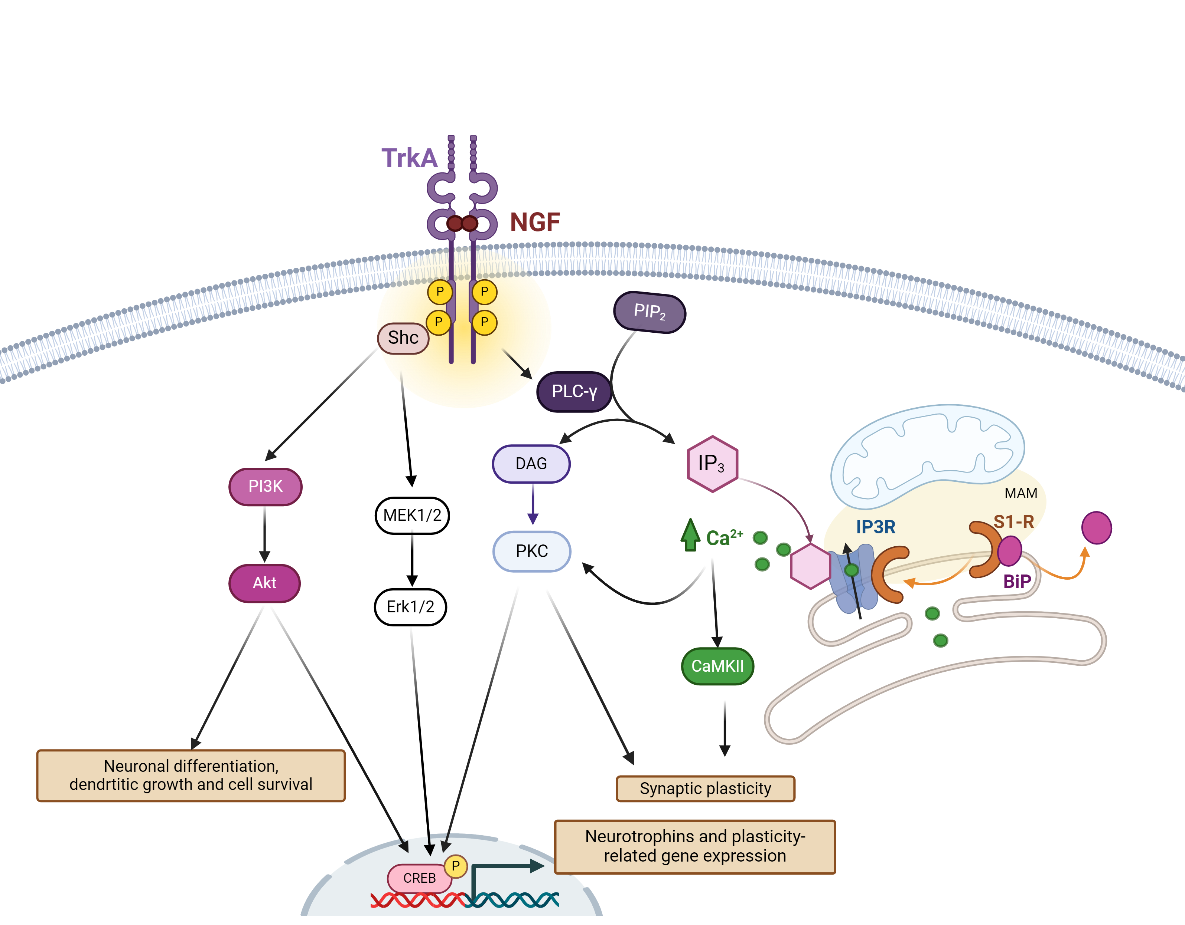
DMT IN PC12 CELL LINE
Effect of DMT on neurite outgrowth
Towards an understanding of the molecular mechanisms
Pharmacological inhibitors
PC12 differentiation by NGF:
TrkA receptor
PI3K/Akt
MEK/Erk
PLCγ
Pathways:
GNF-5837
LY294002
PD98059
U73122
DMT pharmacology:
5-HT_{2A}R
Sigma-1R
Ketanserin
NE-100

Slide 10
DMT IN PC12 CELL LINE
Effect of DMT on neurite outgrowth
Towards an understanding of the molecular mechanisms
Pharmacological inhibitors
  Pathways
    PI3K/Akt
    MEK/Erk
    PLCγ
PLCγ
Akt
Erks
DMT, 72h
PC12 naive
+ inhibitor

Slide 11
DMT IN PC12 CELL LINE
Effect of DMT on neurite outgrowth
Towards an understanding of the molecular mechanisms
Neuritogenesis by DMT seems to depend on PI3K/Akt and PLCγ pathways
Pharmacological inhibitors
DMT +
↓ NGF,
72h
  Pathways
PLCγ
Akt
Erks
    PI3K/Akt
    MEK/Erk
    PLCγ
+ inhibitor
PLCγ
Akt
Erks
DMT, 72h
PC12 naive
+ inhibitor

Slide 12
DMT IN PC12 CELL LINE
Effect of DMT on neurite outgrowth
Towards an understanding of the molecular mechanisms
Trk(A) are fundamental neurite outgrowth in PC12
S1-R is required for DMT-mediated neuritogenesis BUT might play a secondary role when NGF is present
Pharmacological inhibitors
  Receptors
DMT +
↓ NGF,
72h
5-HT_{2A}R
PC12 diff by NGF:
TrkA
S1-R
+ inhibitor
Trk(A)
DMT pharmacology:
5-HT2AR
Sigma-1R
5-HT_{2A}R
Trk
S-1R
DMT, 72h
PC12 naive
+ inhibitor

Slide 13
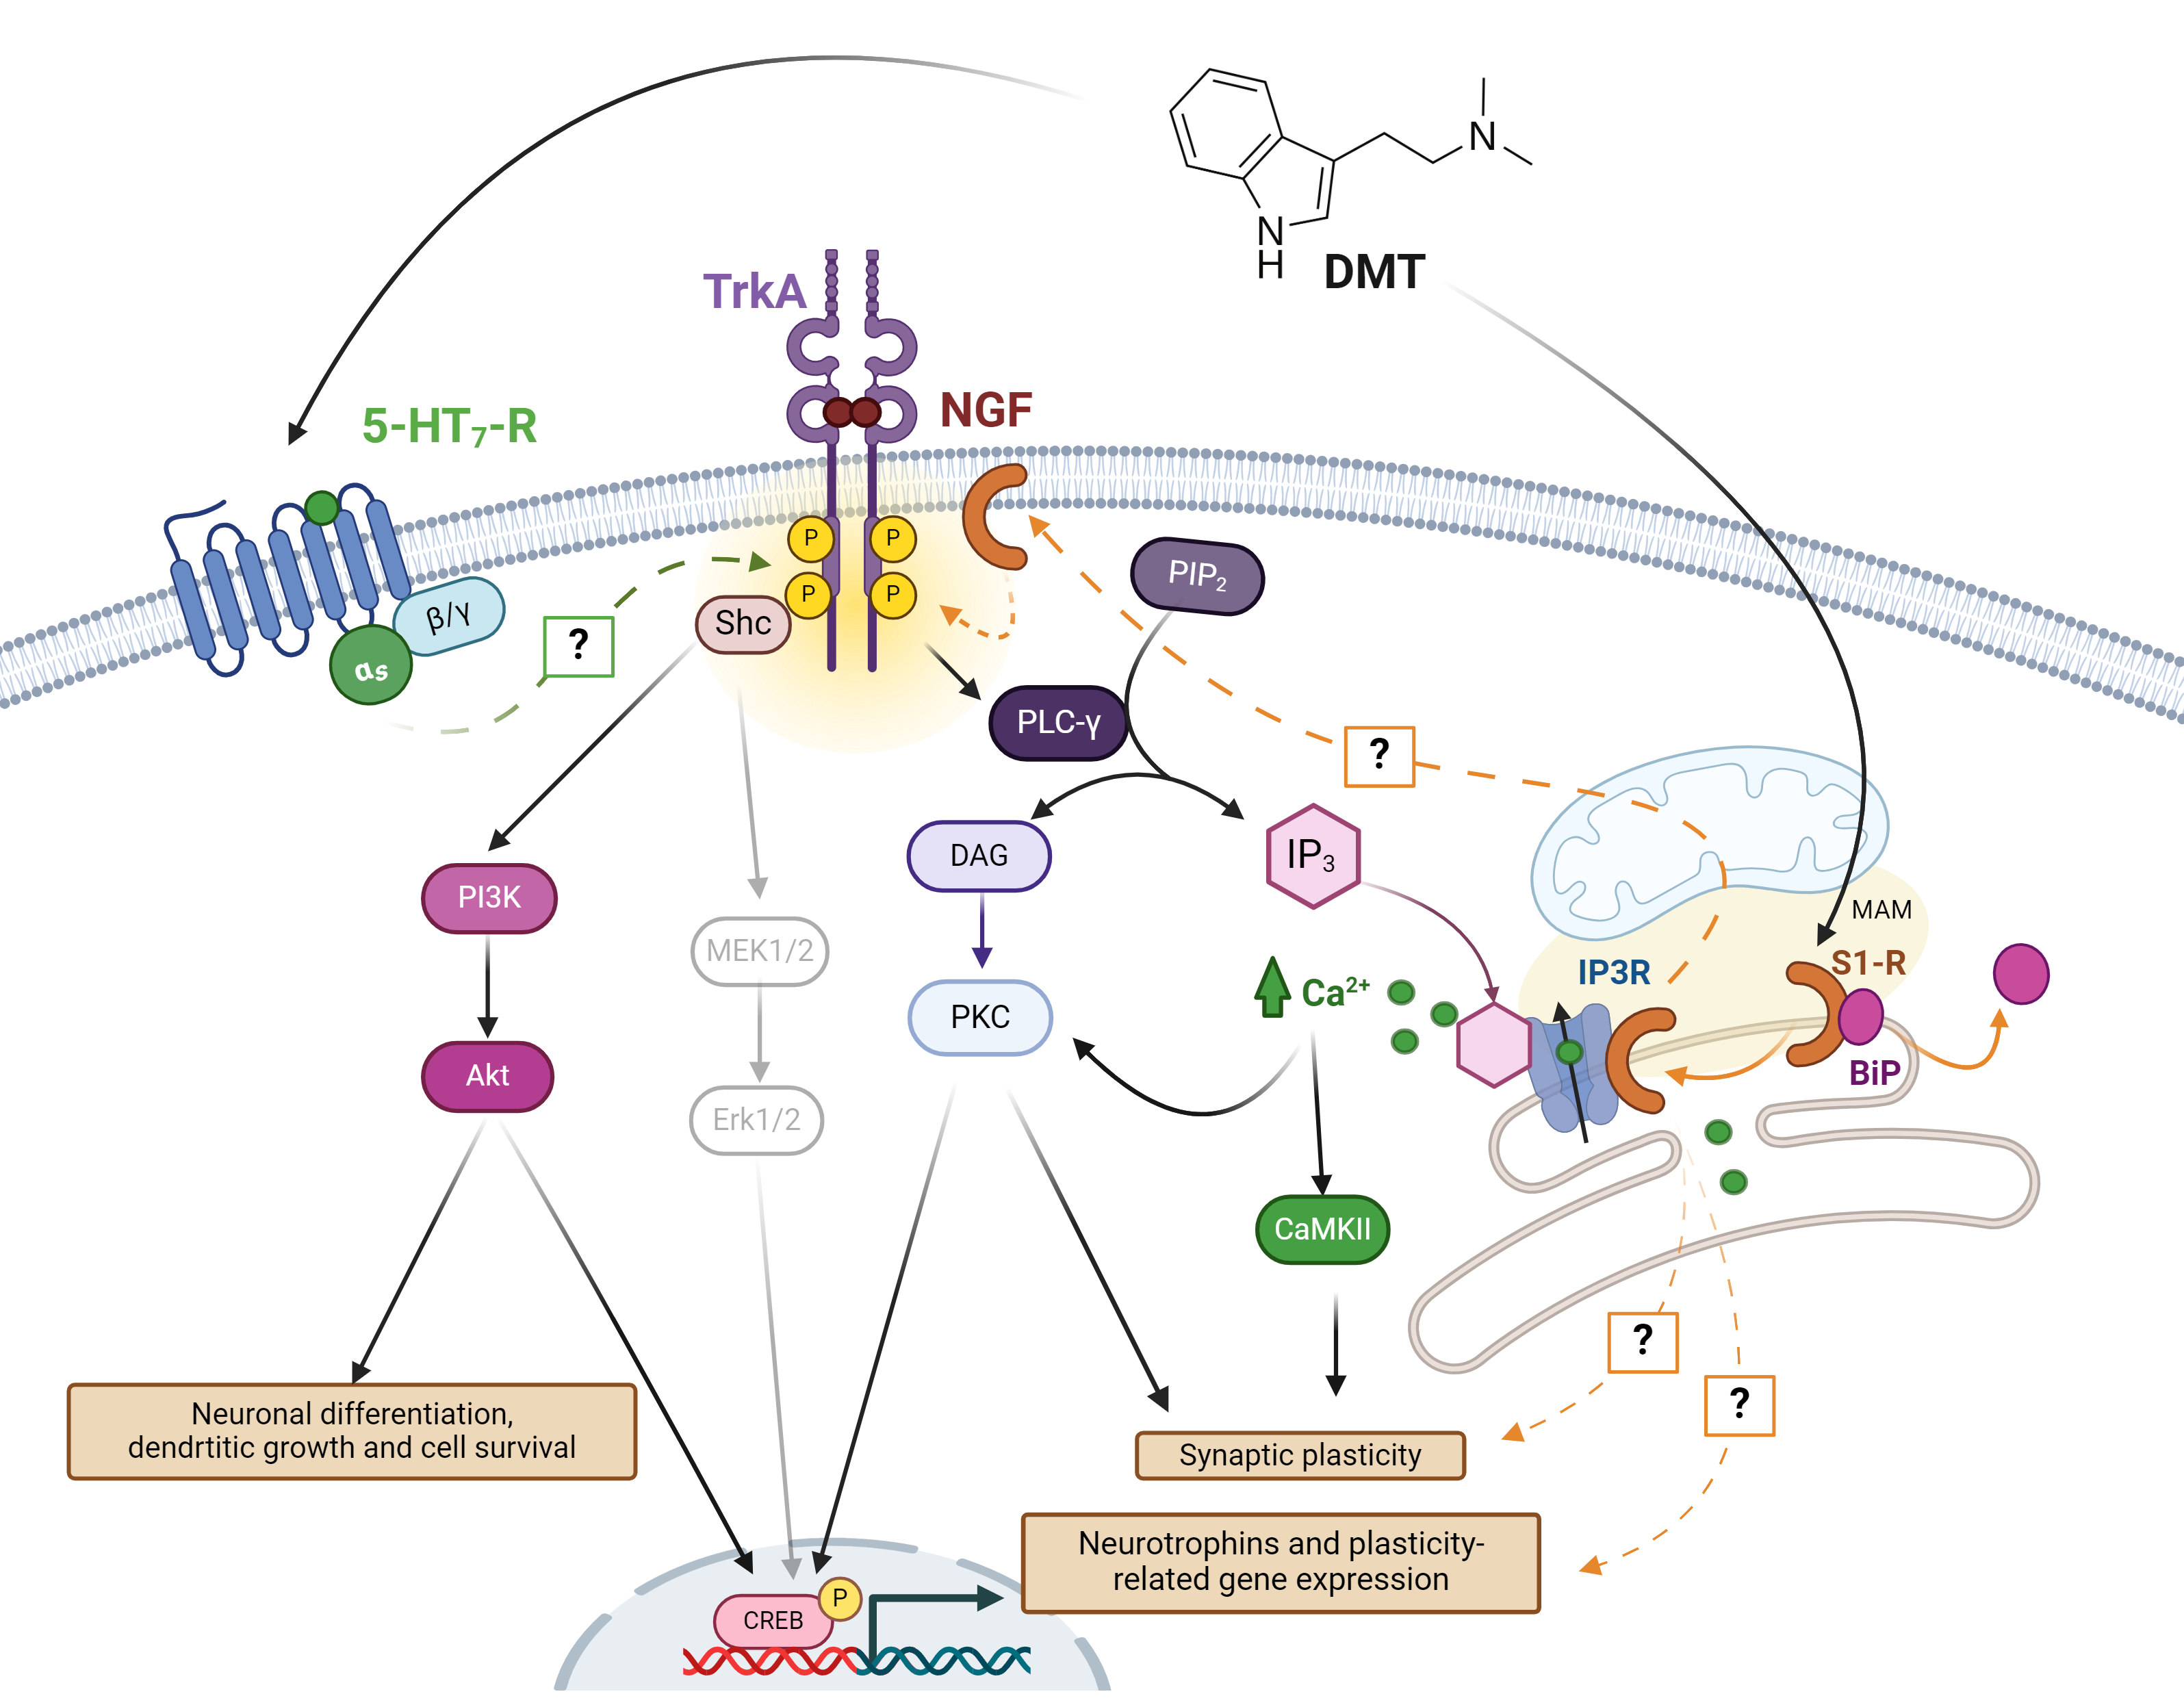
DMT IN PC12 CELL LINE
Concluding remarks and ongoing work
DMT promotes neuritogenesis in PC12 cells.
DMT shows an additive-like effect with NGF, Trk(A)-dependent.
Neuritogenesis by DMT depends on PI3K/Akt and PLCγ pathways.
DMT-medidated neurite outgrowth seems to requiere both Trk(A) and S1-R recpetors.
DMT additive effect on NGF-medidated neurite outgrowth does not depend on S1-R.

Slide 14
DMT IN PC12 CELL LINE
Concluding remarks and ongoing work
Towards an understanding of the molecular mechanisms
Inderect activation of Trk(A) by DMT?
Trk indirect activation
GPCRs
Other?
S1-R

Slide 15

DMT IN PC12 CELL LINE
Effect of DMT on neurite outgrowth
ON-GOING WORK
Inderect activation of Trk(A) by DMT?
Trk indirec tactivation
GPCRs
Other?
S1-R
DMT promotes sigma-1 direct interaction with TrkA?
Upon activation S-1R directly interacts with TrkB in Cerebellar Granule Neurons and promotes neurtite elongation
Y. Kimura, Y. Fujita, K. Shibata, M. Mori, T. Yamashita, PLoS One 2013, 8, 75760.
Sigma-1 modulates TrkB in hippocampal neurons
M. Ka, Y. H. Kook, K. Liao, S. Buch, W. Y. Kim, Cell Death Dis. 2016, 7, 1–13.

Slide 16
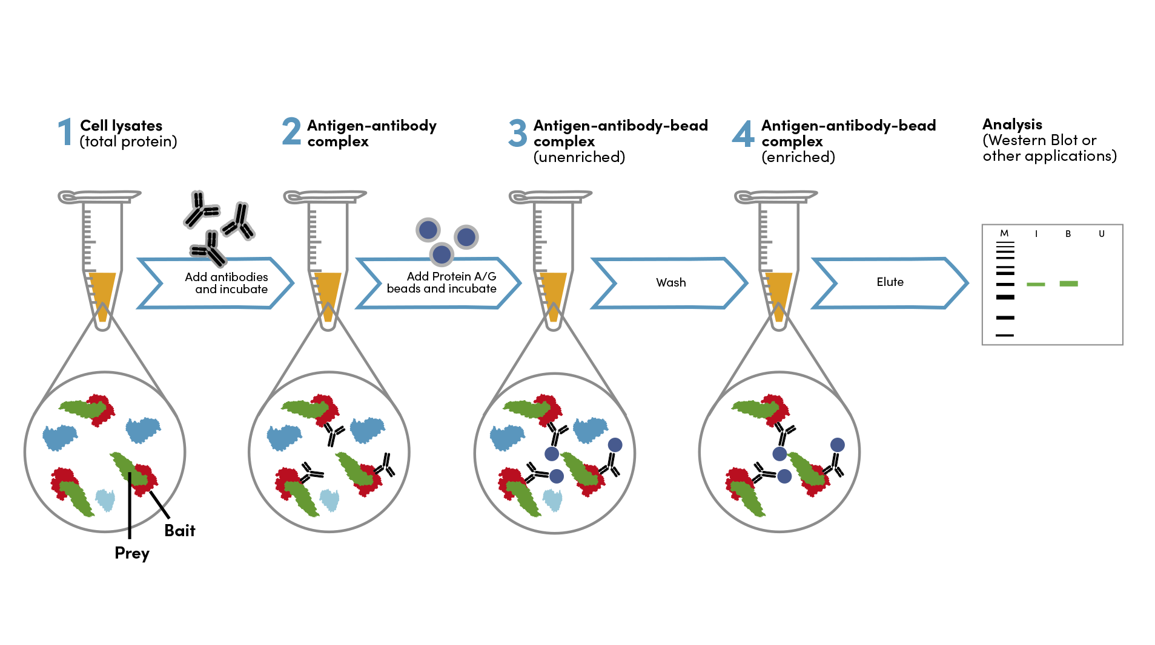
DMT IN PC12 CELL LINE
Effect of DMT on neurite outgrowth
ON-GOING WORK
PC12: Sigma-1 receptor / TrkA Co-IP
DMT promotes sigma-1 direct interaction with TrkA?
Upon activation S-1R directly interacts with TrkB in Cerebellar Granule Neurons and promotes neurtite elongation
Y. Kimura, Y. Fujita, K. Shibata, M. Mori, T. Yamashita, PLoS One 2013, 8, 75760.
Sigma-1 modulates TrkB in hippocampal neurons
M. Ka, Y. H. Kook, K. Liao, S. Buch, W. Y. Kim, Cell Death Dis. 2016, 7, 1–13.

Slide 17






!
THANK YOU
for your kind attention
organizing committee
Researchers team
Lic. Juani Narbondo
Dr. Giselle Prunel
Dr. Ignacio Carrera
Dr. Bruno González
Financial aid

