Slide 1


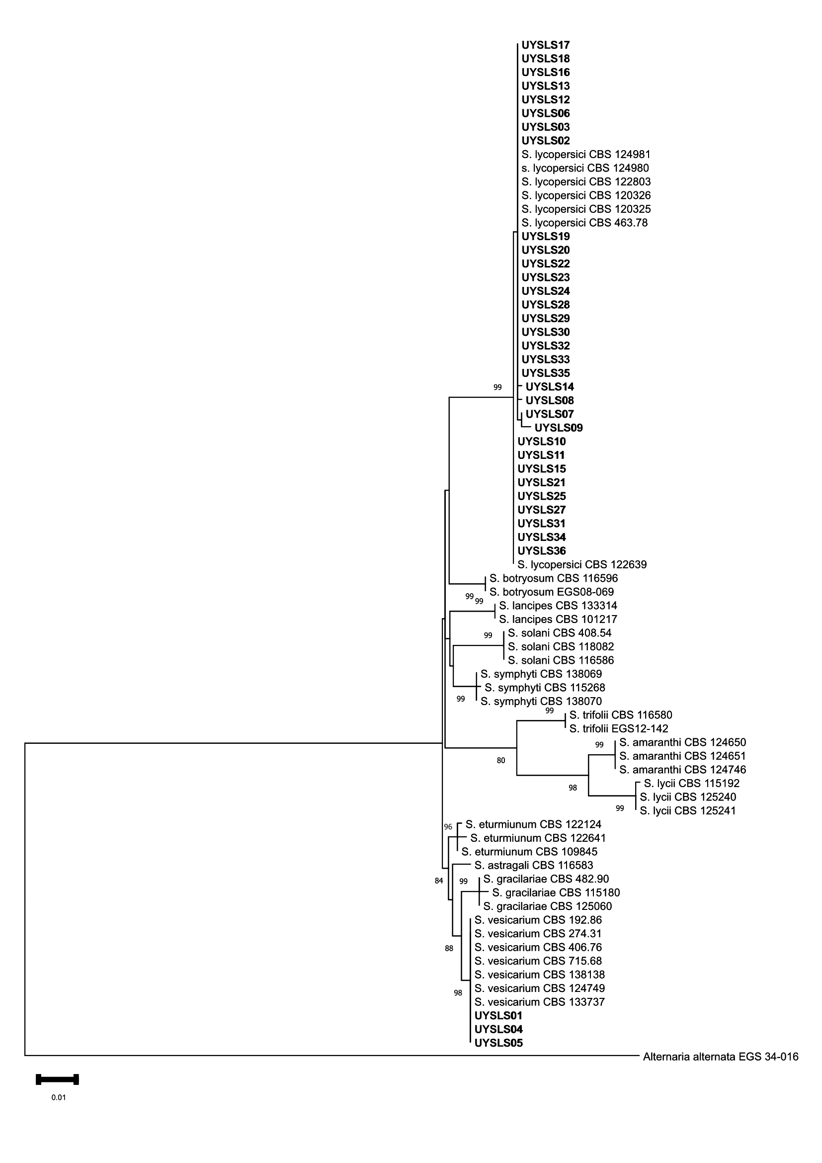
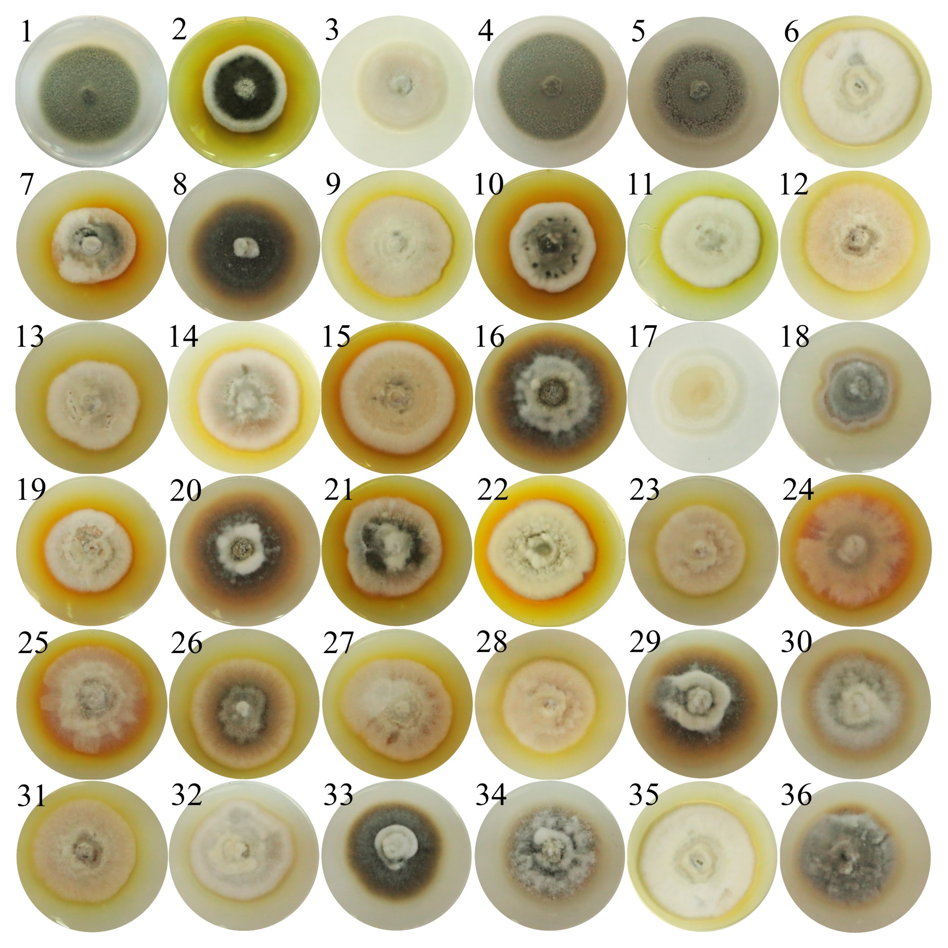
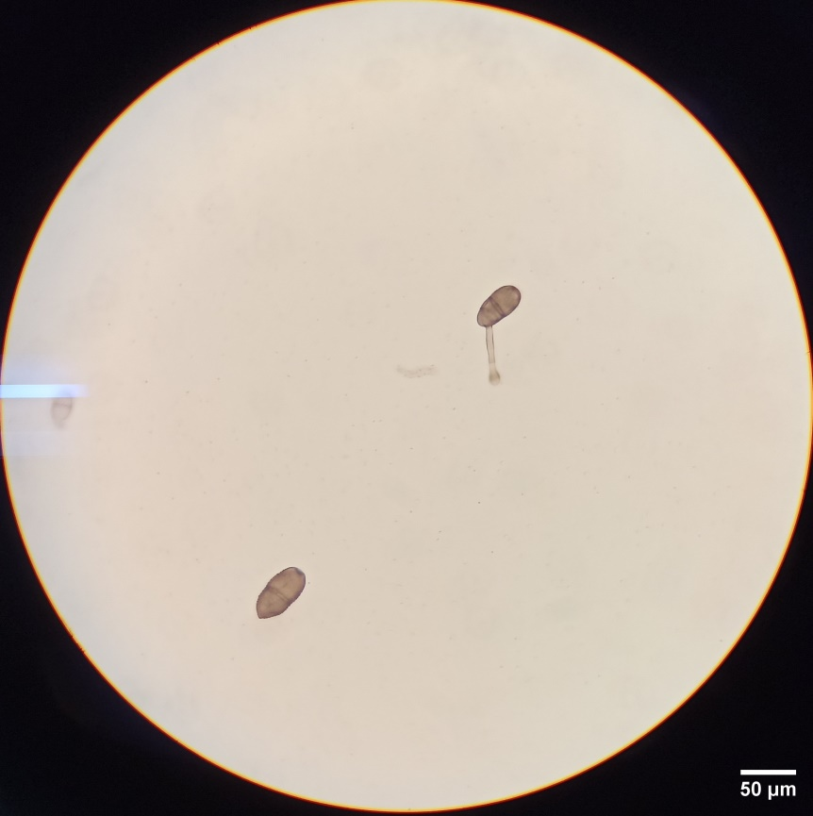
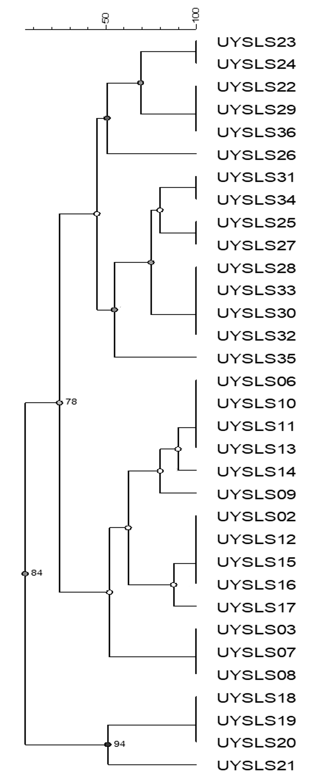
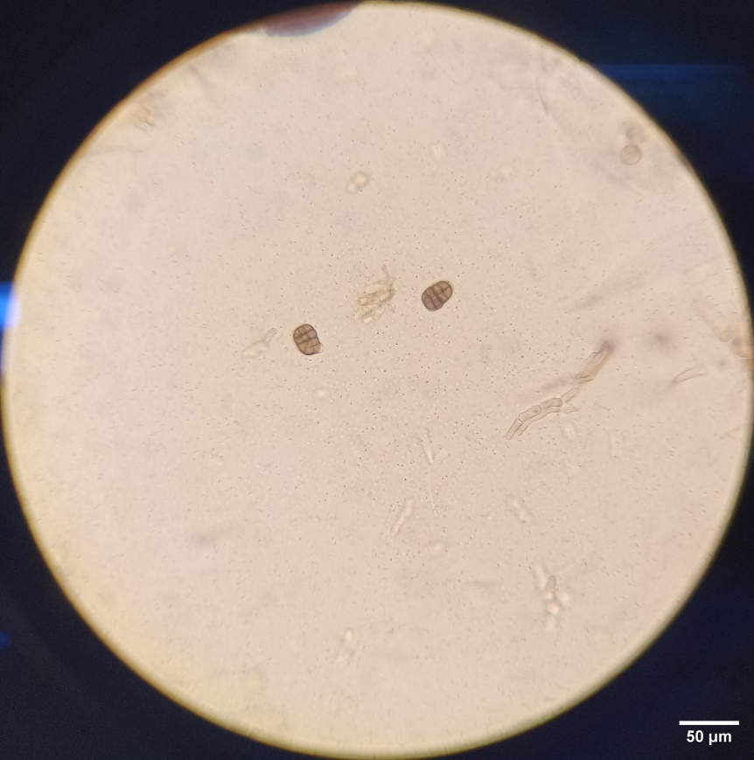
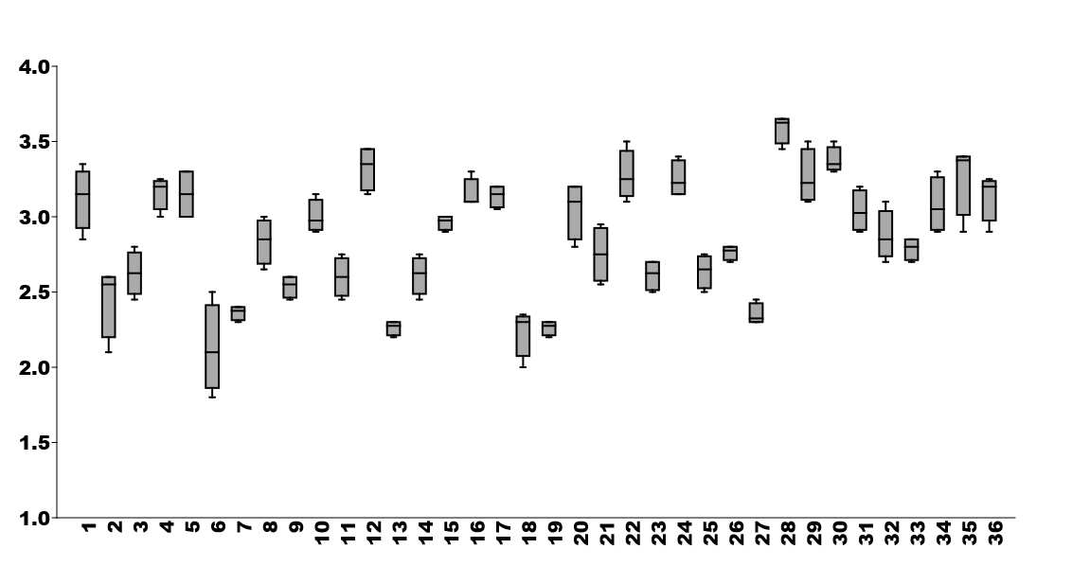
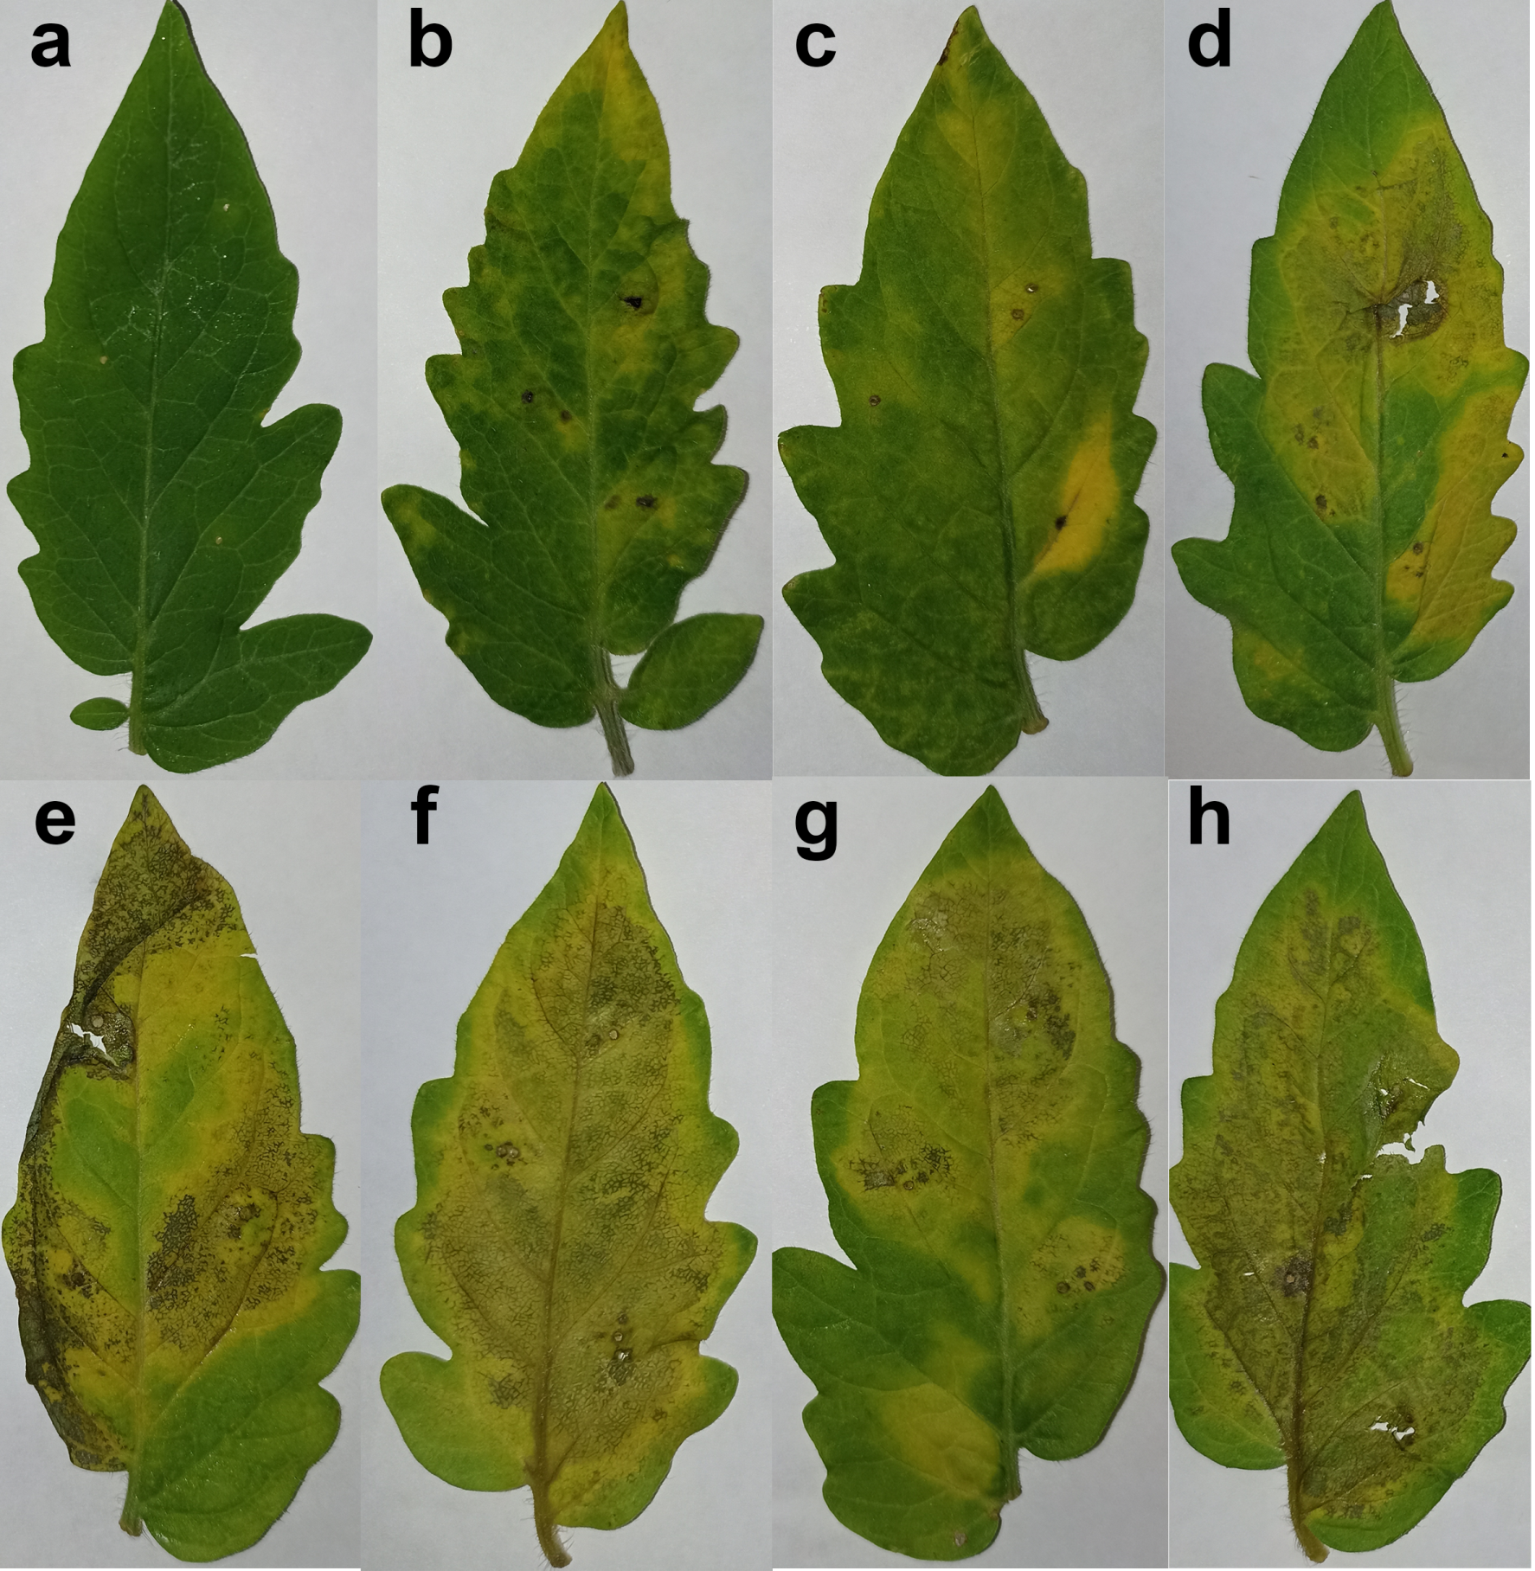
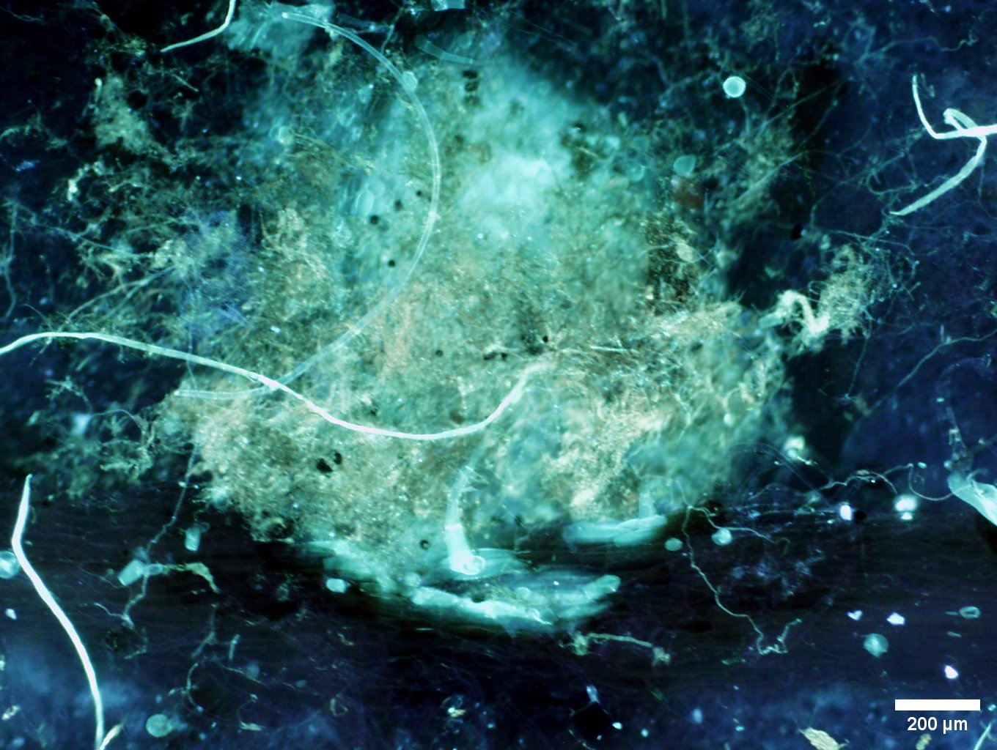
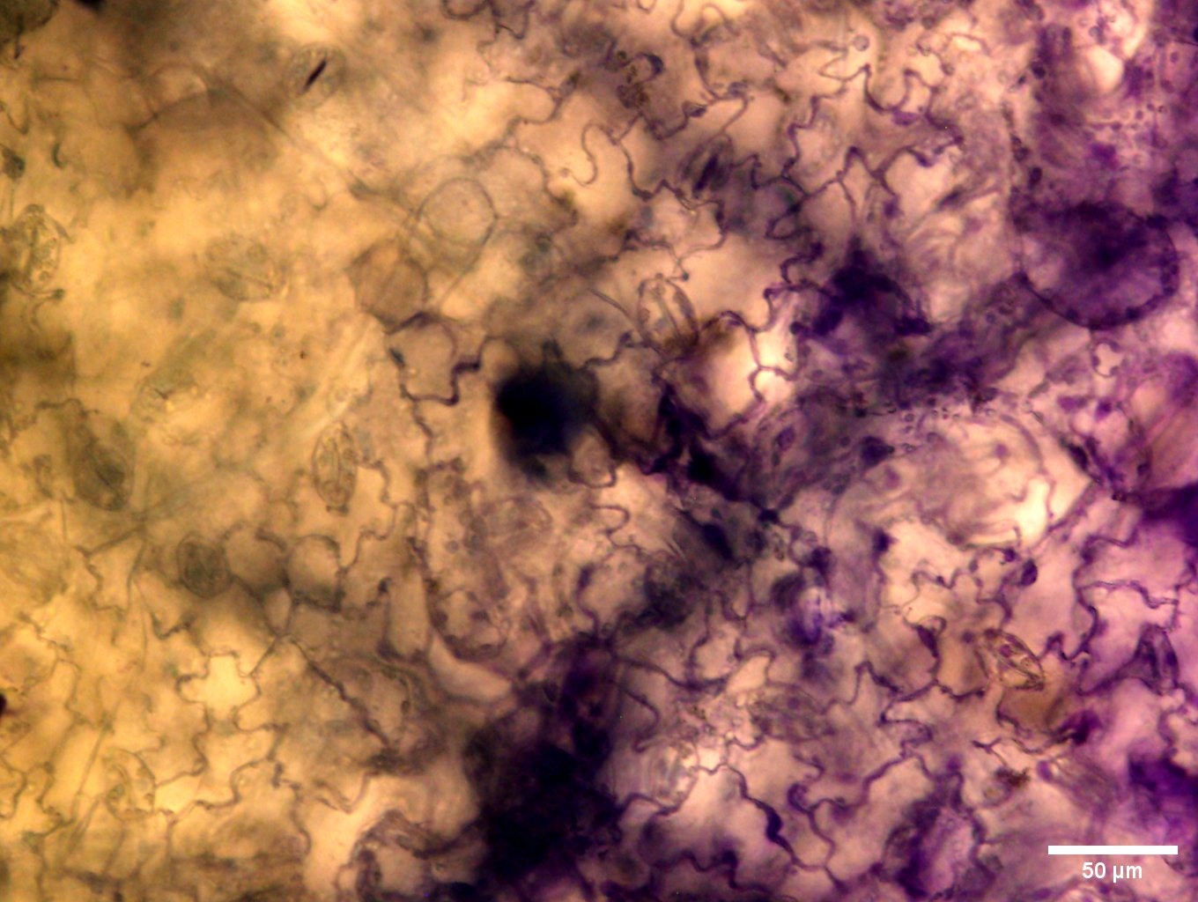
Identification and characterization of Stemphylium species causing gray leaf spot of tomato in Uruguay
Ana Clara González ¹, Leticia Rubio ², Eilyn Mena ¹, Leonardo Delgado-Cerrone¹, Ana Arruabarrena ², Matías-Gonzáles-Arcos² e Inés Ponce de León ¹.
¹ Departamento de Biología Molecular, Instituto de Investigaciones Biológicas Clemente Estable, Montevideo, Uruguay
² Instituto Nacional de Investigación Agropecuaria- INIA Salto Grande, Uruguay
INTRODUCTION
Tomato (Solanum lycopersicum L.) is a crop of great importance worldwide and it is the second most important horticultural crop in Uruguay. Fungi of the genus Stemphylium cause tomato gray leaf spot, a destructive disease responsible for large production losses in susceptible tomato varieties.
OBJETIVE
The objective of the present work was to identify the Stemphylium species associated with gray leaf spot of tomato in Uruguay and evaluate the genetic diversity and aggressiveness of the isolates.
RESULTS
Identification of Stemphylium species present in Uruguay
Morphological characterization, growth and study of genetic diversity
a)
b)
UYSLS32
c)
UYSLS01
d)
Radial growth (cm)
Isolates
36 Stemphylium isolates collected from different departments were analyzed, identifying S. lycopercisi as the predominant species in Uruguay.
a) Front picture of the isolates; b) Conidia of the isolates S. lycopercisi UYSLS32 and S. vesicarium UYSLS01; c) Dendrogram of the genetic diversity of S. lycopercisi isolates obtained with ISSRs markers; d) Box-plot of growth rate in PDA medium at 7 days at 25°C in the dark.
c)
Colonization and symptoms development in tomato plants
(-)
01
20
22
a)
b)
UYSLS32
UYSLS20
UYSLS32
24
28
29
32
200 µm
a) Mycelium growth of UYSLS32 and UYSLS20 at 9 dpi (solophenyl staining); b) cell wall reinforcement of leaves infected with UYSLS32 at 9 dpi (safranin staining); c) Symptom development after inoculating isolates belonging to different groups of S. lycopercisi in detached leaves.
CONCLUSIONS
S. lycopercisi was identified as the predominant species in tomato crops in Uruguay, and the different isolates were classified according to their genetic diversity into three main groups.
S. lycopercisi isolates exhibited differences in mycelium growth progression and level of aggressiveness. We identified a highly virulent isolate (UYSLS32) and a slightly virulent isolate (UYSLS20).
Financial support: Research grant ANII FCE_1_2021_1_166555, Uruguay.

