Slide 1



Estimation of the perception of technology adoption costs by cow-calf ranchers in Uruguay
Federico García-Suárez

Slide 2
Motivation
Uruguay’s animal protein production has two large export sectors and two national oriented sectors.
Main research focus in livestock and dairy farming.
How to build competitiveness in an export country?
Efficiency and productivity.
Technology adoption.

Slide 3
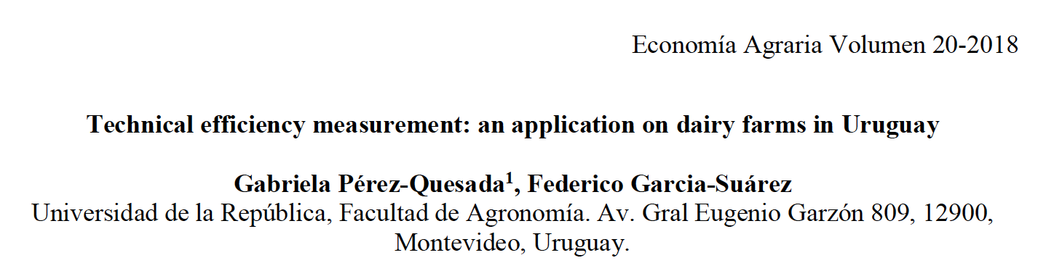
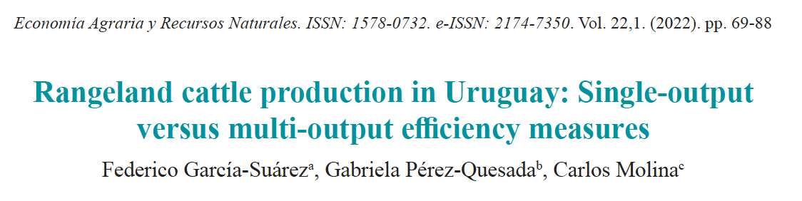
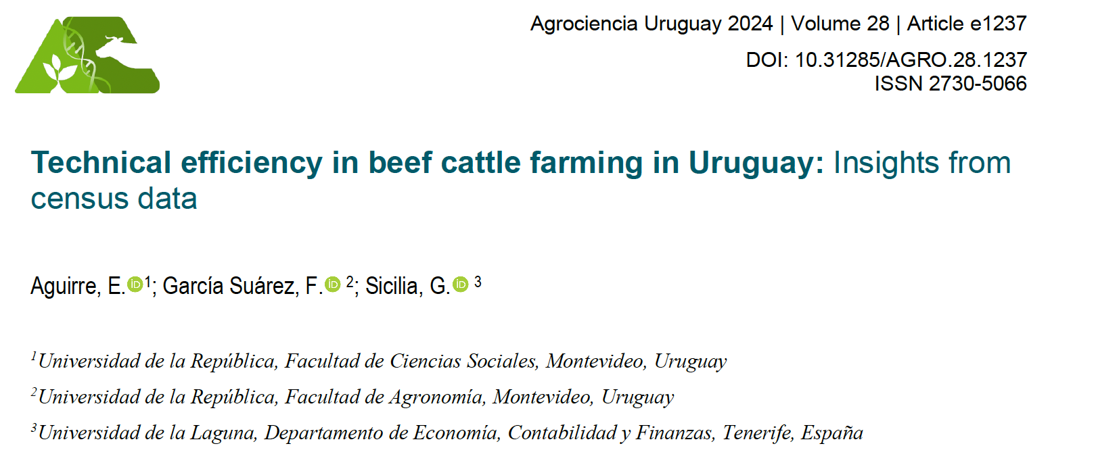
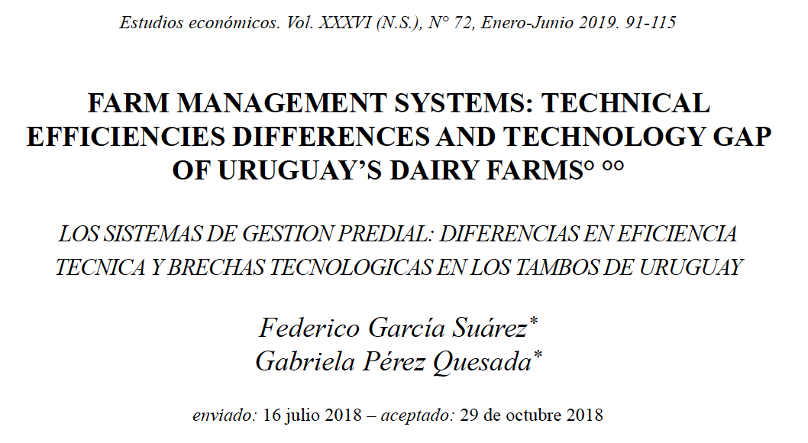
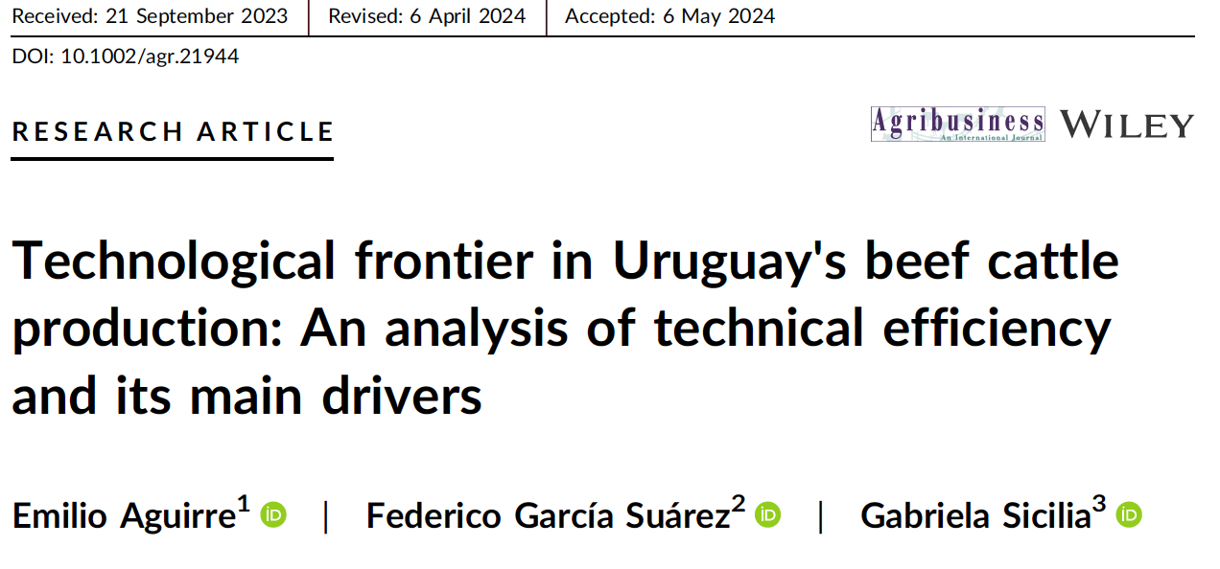

Slide 4
The cow-calf sector, is a two output sector?
Breeding subsector has historically shown a lower weaning performance indicator (66%) than what the academia show as possible (80%).
Low-cost technology is available, but what about its opportunity cost?
The objective of this study is to estimate, through a survey experiment, the perceived cost of two management practices used to improve reproductive performance: condition scoring (BCS) and temporary weaning (TW).

Slide 5
Metodology
Technology marginal propensity adoption is estimated using a factorial design of four treatments and three dosis in random blocks.
Treatments 1 and 3 differs in information.
Treatments 2 and 4 introduce reimbursment levels over previous information.
What is offered is technical assistance to adopt the technology evaluated.

Slide 6
Variables to be evaluated in the model
 |  | Information level
 | 1 | 2 | 3
Tratamiento | Condition scoring
T1: CS information | No information | General CS information | Benefits from CS measurement
T2: CS technical assistance hiring | 0% reimbursement | 25% reimbursement | 80% reimbursement
 | Temprorary weaning
T3: TW information | No information | General TW information | Benefits from TW measurement
T4: TW technical assistance hiring | 0% reimbursement | 25% reimbursement | 80% reimbursement

Slide 7
Data and empirical model
We used to information sources to ranchers, IPA and EBPMCN.
From the statistical analysis and considering a Type-I error level of 0.05, a expected treatment effect of 0.2, and a statistical power of 80%, we requiere 35 to 40 surveys per treatment.
Blocking based on initial databases, randomization of information, and subsidies. Not based on technology or cross-subsidies.
216 effective survey were performed, of which136 ranchers did not perform CS, and 109 did not use TW.

Slide 8
Treatment results and average treatment effect (ATE) of condition scoring
Treatment | Connected | Do not use the technology | Treatment acceptance | ATE
T1.1 | 73 | 48 | 13 | 0.271
T1.2 | 69 | 51 | 13 | 0.255
T1.3 | 74 | 37 | 7 | 0.189
T2.1 | 80 | 50 | 11 | 0.220
T2.2 | 76 | 44 | 8 | 0.182
T2.3 | 60 | 42 | 14 | 0.333

Slide 9
Treatment results and average treatment effect (ATE) of temporary weaning
Treatment | Connected | Do not use the technology | Treatment acceptance | ATE
T1.1 | 72 | 41 | 7 | 0.171
T1.2 | 73 | 36 | 4 | 0.111
T1.3 | 71 | 32 | 11 | 0.344
T2.1 | 77 | 36 | 10 | 0.278
T2.2 | 77 | 41 | 5 | 0.122
T2.3 | 62 | 32 | 7 | 0.219

Slide 10
Regression results of information treatment on covariables shows that for CS:
producers know the technology and,
adding information do not change adoption response.
For the TW adding economic information (level 3) increases the propensity to adopt the technology.
Reimbursment treatments show that adoption is independent of the offered amount.
The overall results indicate that the technology is well understood and that non-adoption is not constrained by financial costs.

Slide 11
This is a first approach to the problem.
Results show that reason to non-adoption are related to opportunity cost of learning and management and not by financial costs.
Future research paths includes survey experiments for deepening knowledge on technology adoption, willigness to accept incentives to adopt technology or engage in conservation as well as climate change related practices.
It would be very important to have a regional/international dimension in these approaches.

Slide 12
Thank you!
Questions welcomed.
fgarcia@fagro.edu.uy

